Slide 1
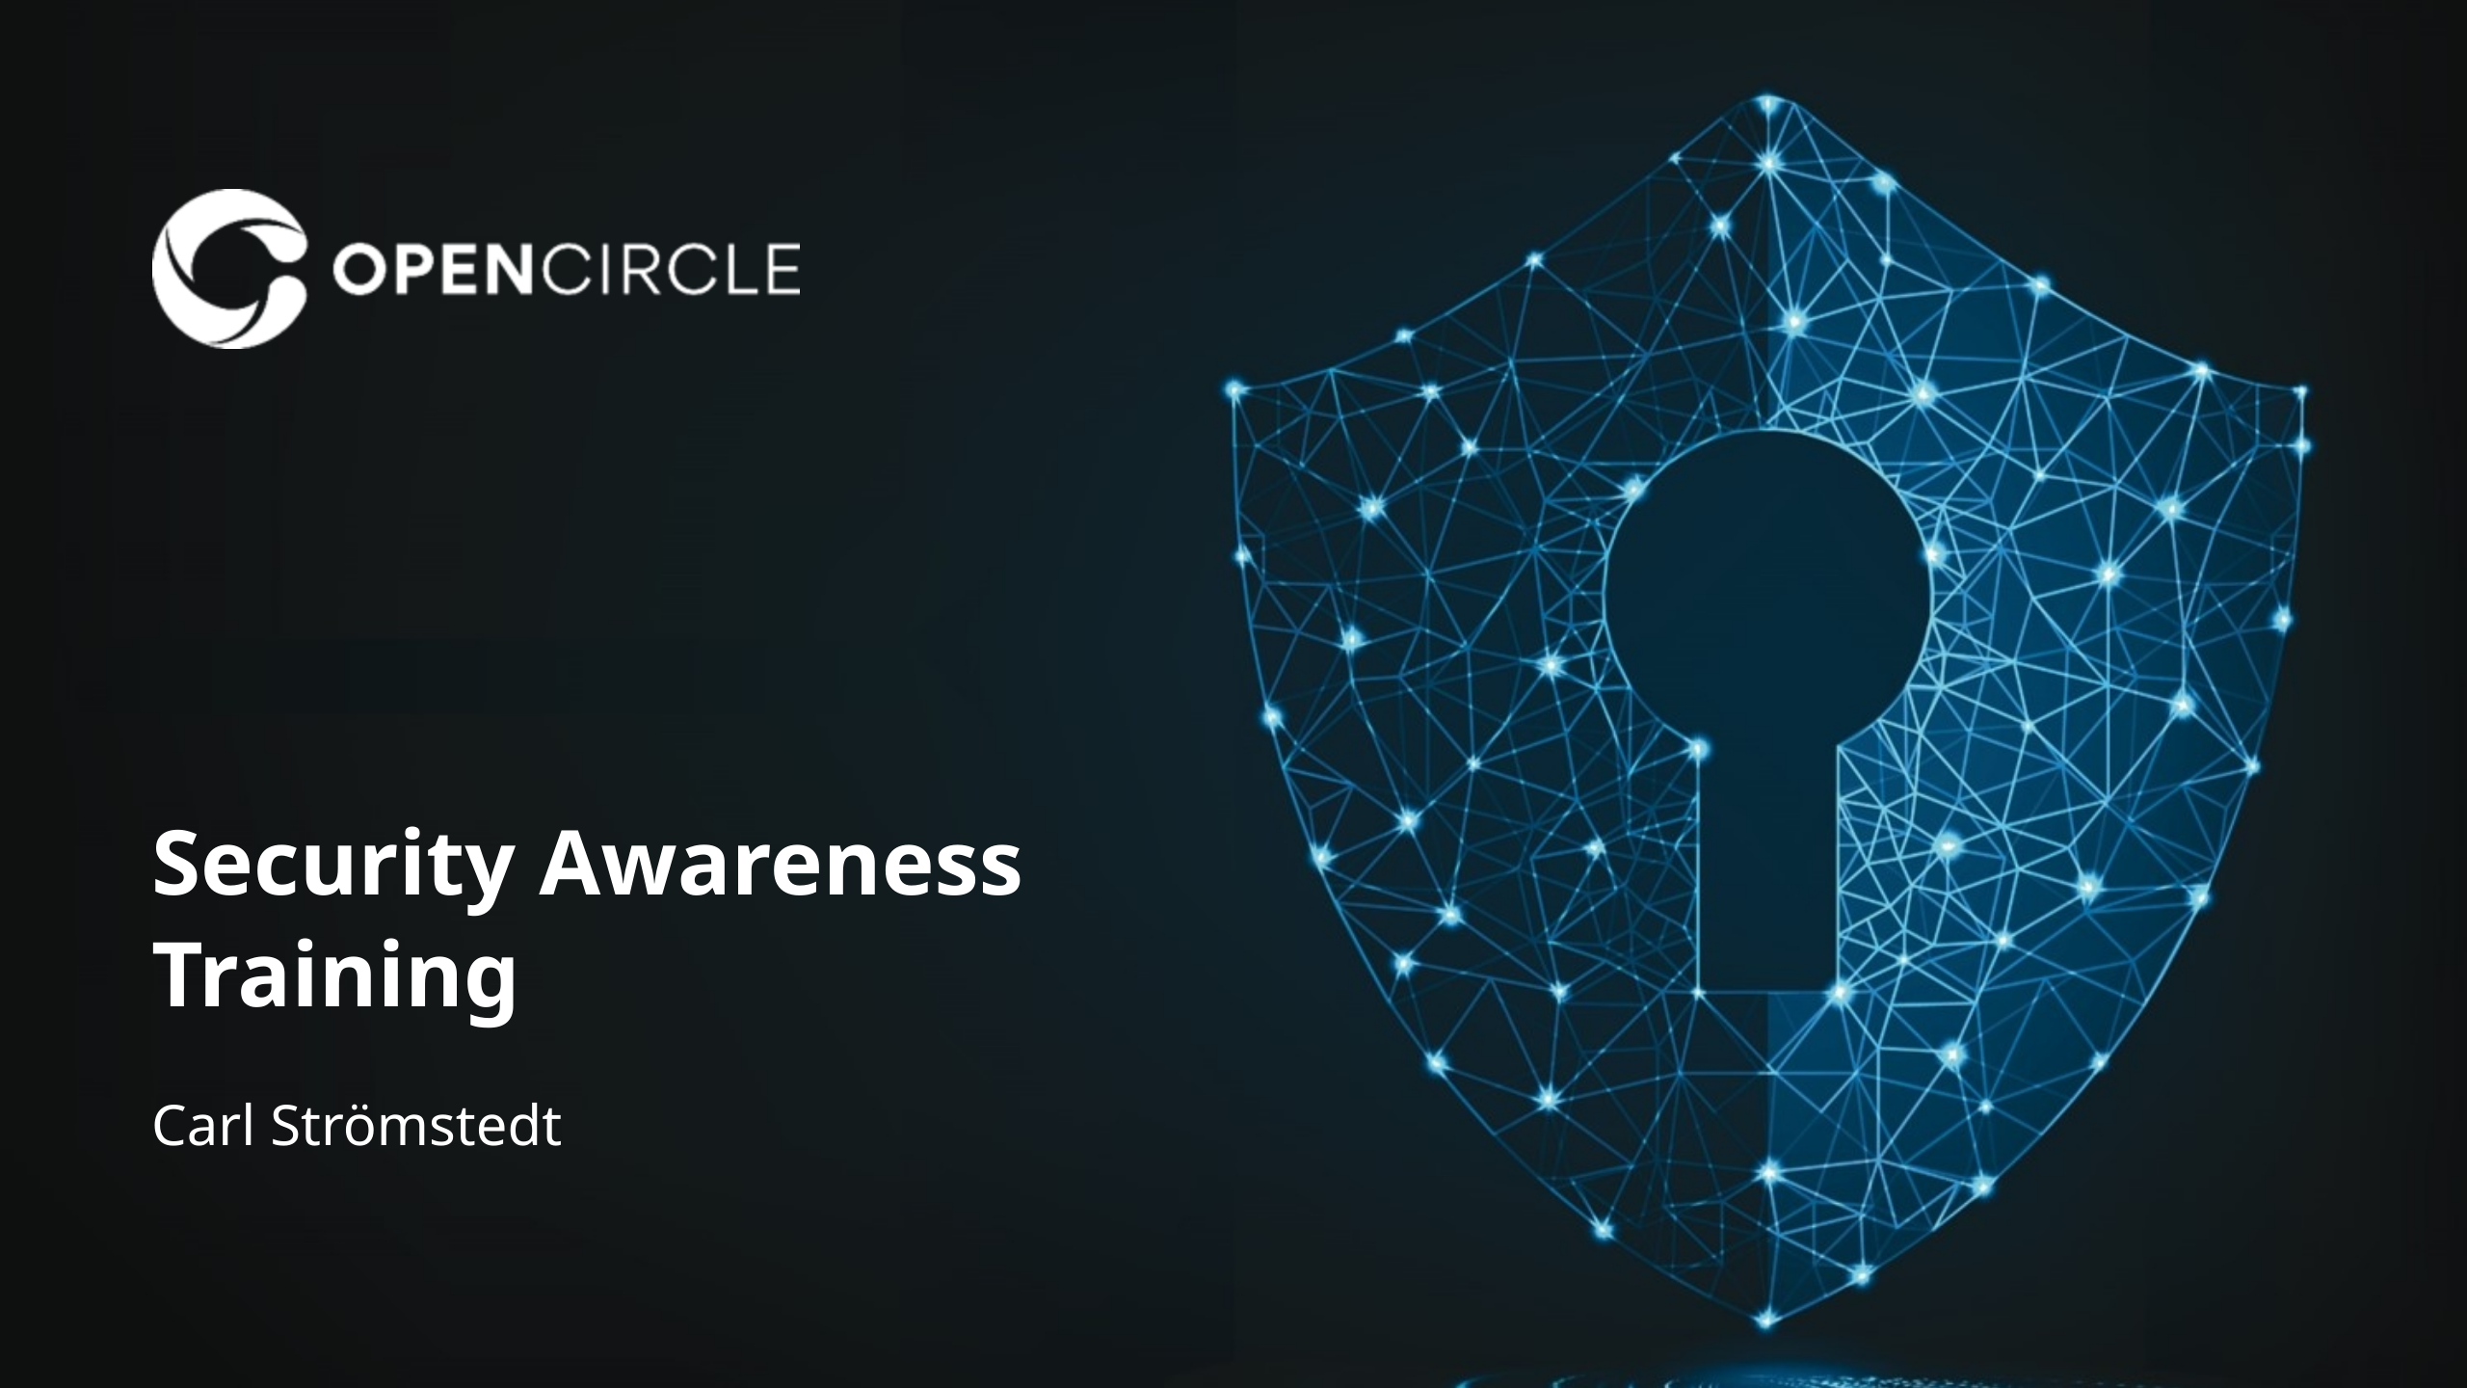

Slide 2
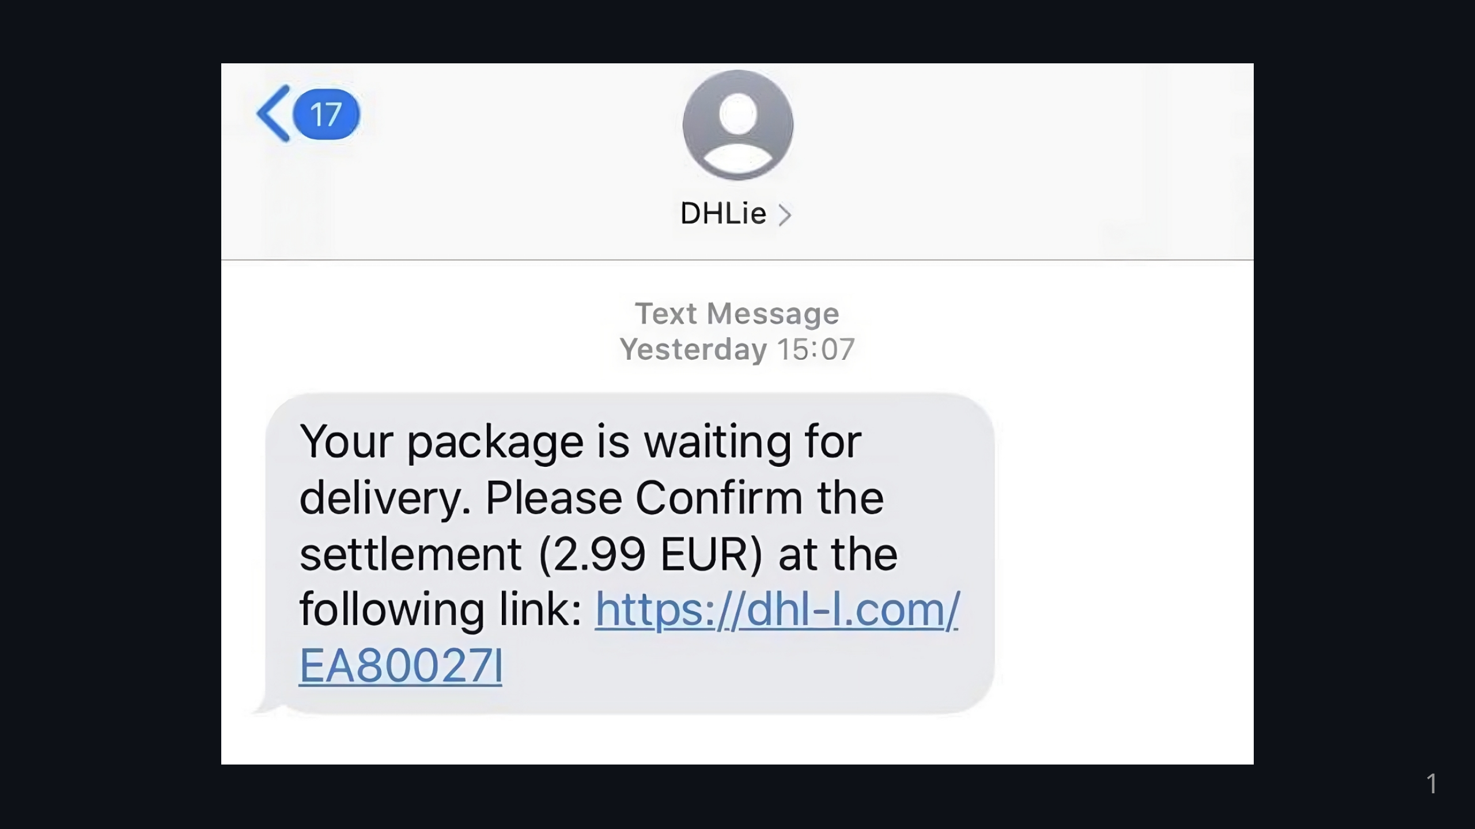
Notes:
Some of you have probably received an SMS like this or similar

Slide 3
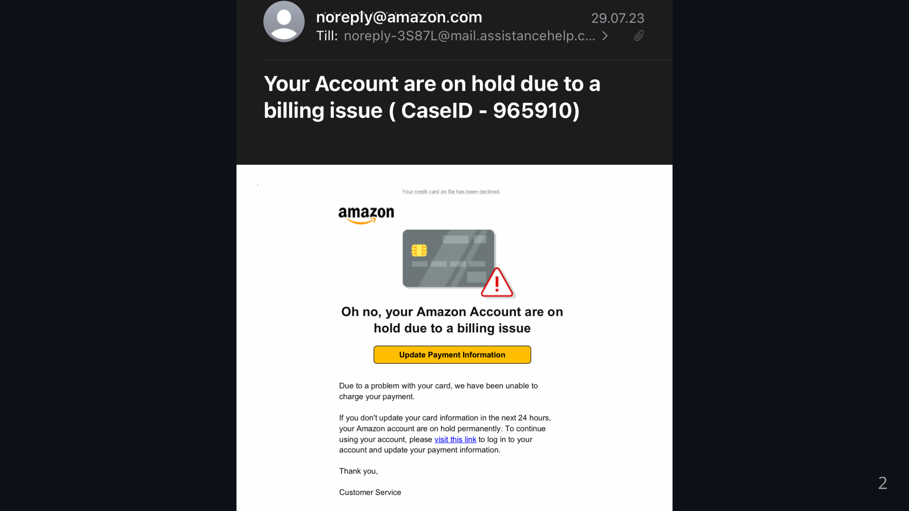
Notes:
Many of you have probably received an email like this or similar

Slide 4
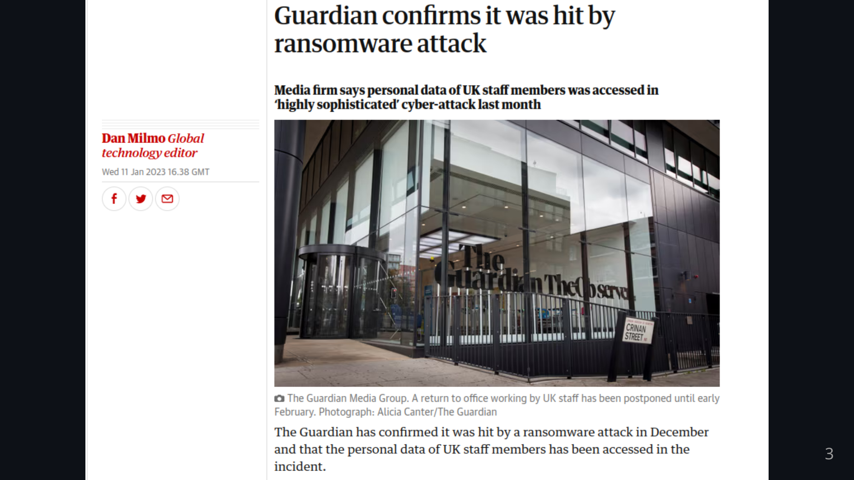
Notes:
And have probably also read about ransomware or other cyber attacks online or in the newspaper

Slide 5
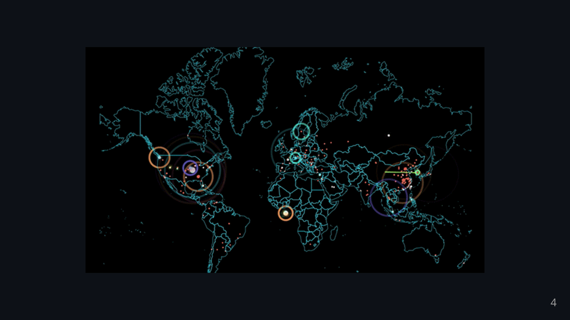
Notes:
Fact is: There are thousands of cyber attacks happening every day

Slide 6
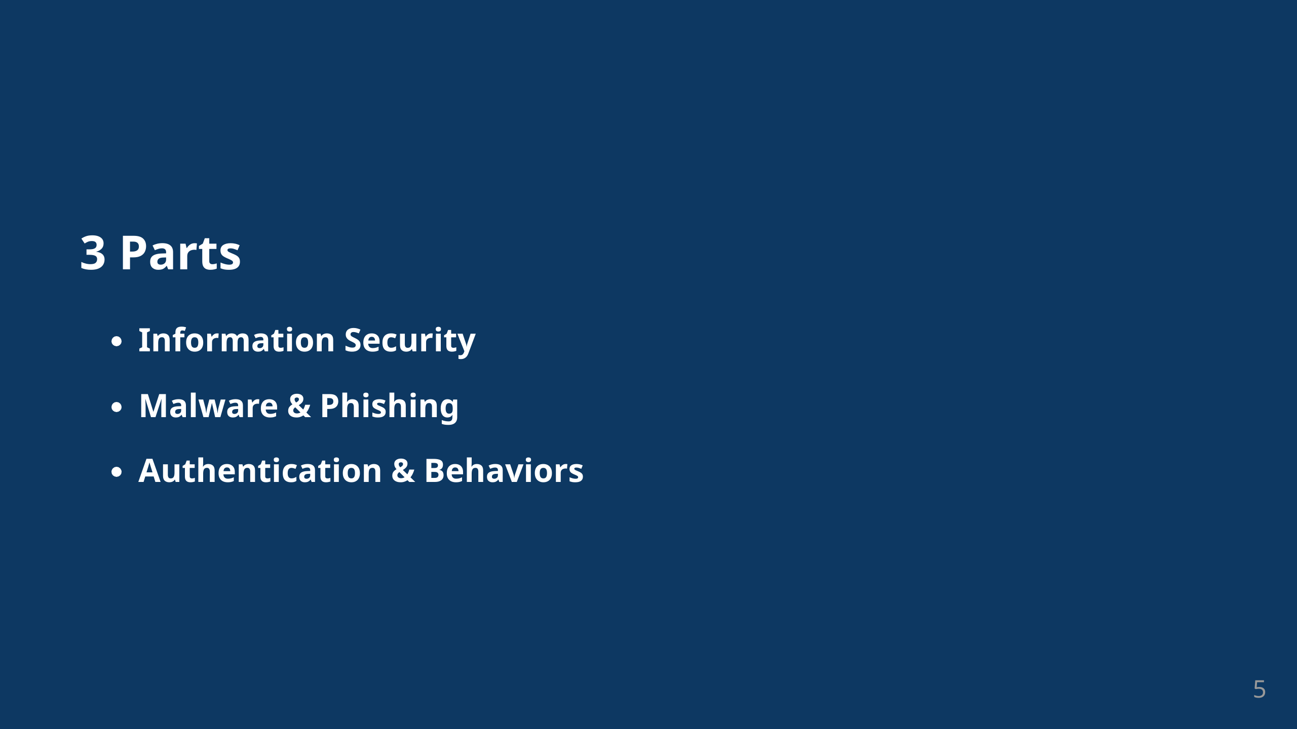
Notes:
Today we will take a look behind these attacks. We will look at the theoretical parts of information sercurity in the first part We will then look at malware and phishing with technical processes including social aspects And to finishour training we will look at authentication & behaviours in digital spaces and in the workplace

Slide 7
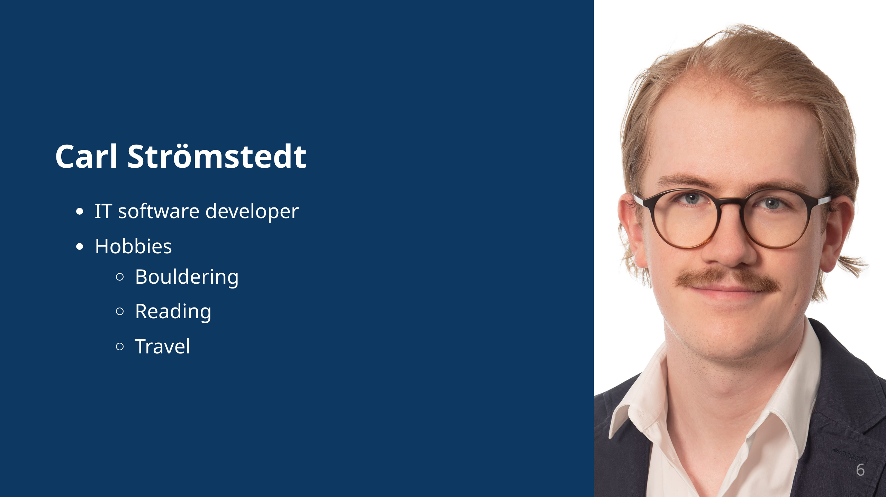

Slide 8
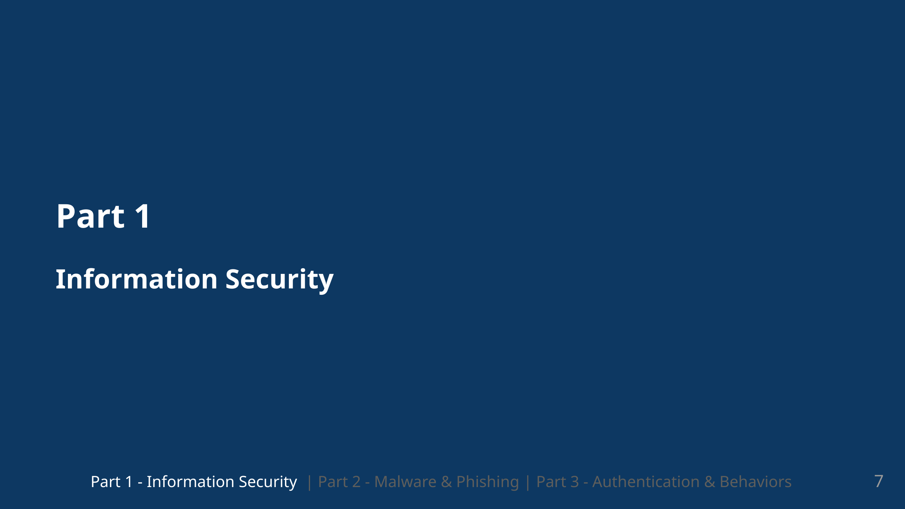

Slide 9
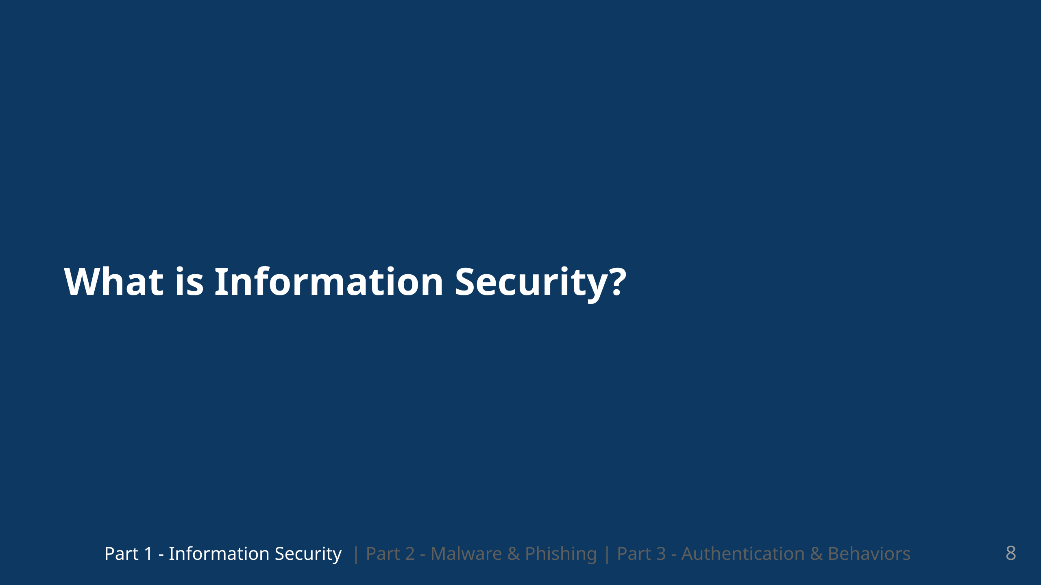
Notes:
What do we actually mean when we are talking about information security?

Slide 10
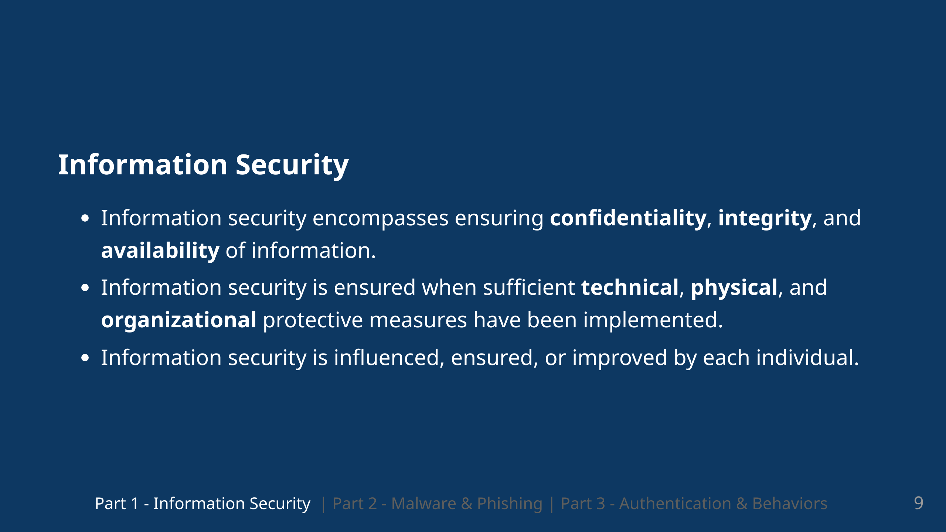
Notes:
We usually define information Security as security centered around the three components Security, Confidentiality and Availability of information We call it the CIA triad and it is a longstanding concept of Information Security. And we can ensure that these security goals are met when we provide infrastructure. Infrastructure in the form of technical physical and organizational protective measures. You as individuals however, also have a big influence on information security. The goal of todays training is that you should at least be able to ensure information security and maybe even improve it?

Slide 11
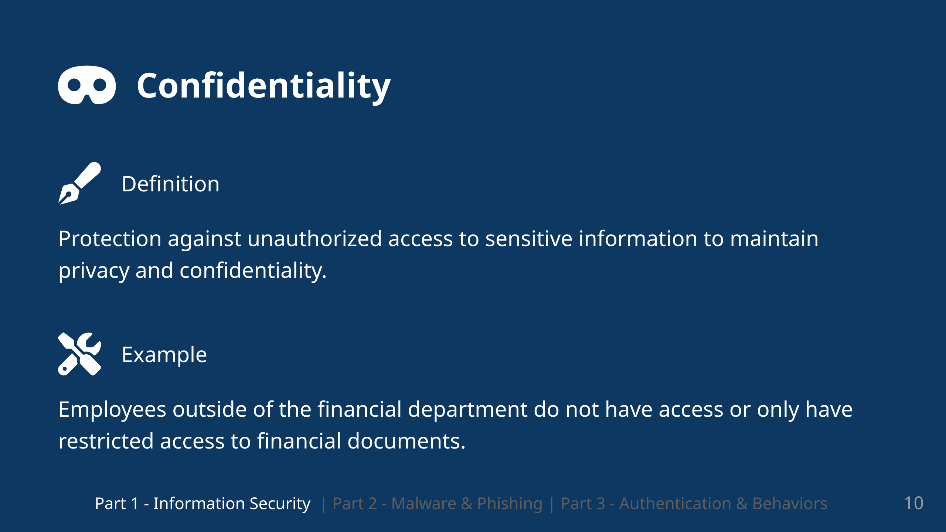
Notes:
We can provice confidentiality if we protcet our information against unauthorized access A concrete example would be that only employees that work for the financial department should have access to all financial documents.

Slide 12
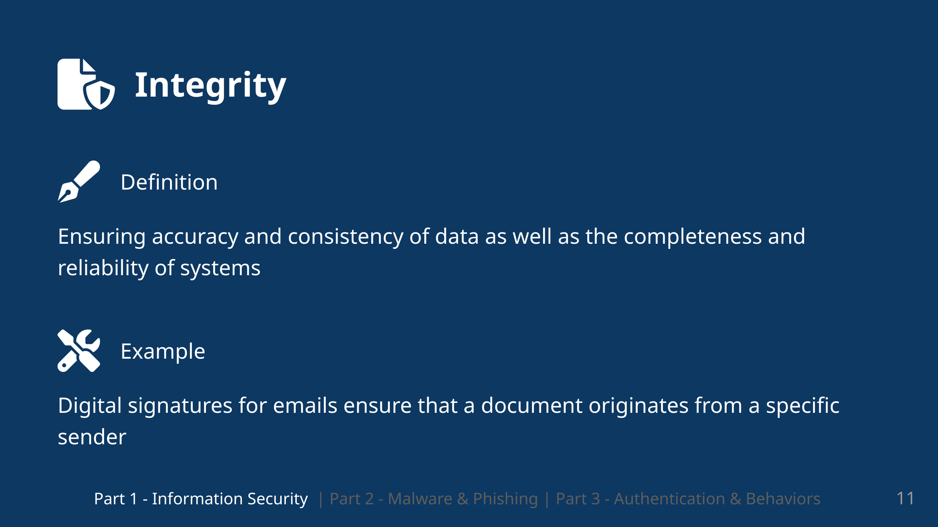
Notes:
Integrity of Information is focuse on ensuring accuracy and consistenc of data, but also completeness and reliability of systems. We want to ensure that Documents are in an origianl state and if they are changed, then we should be able to trace these changes

Slide 13
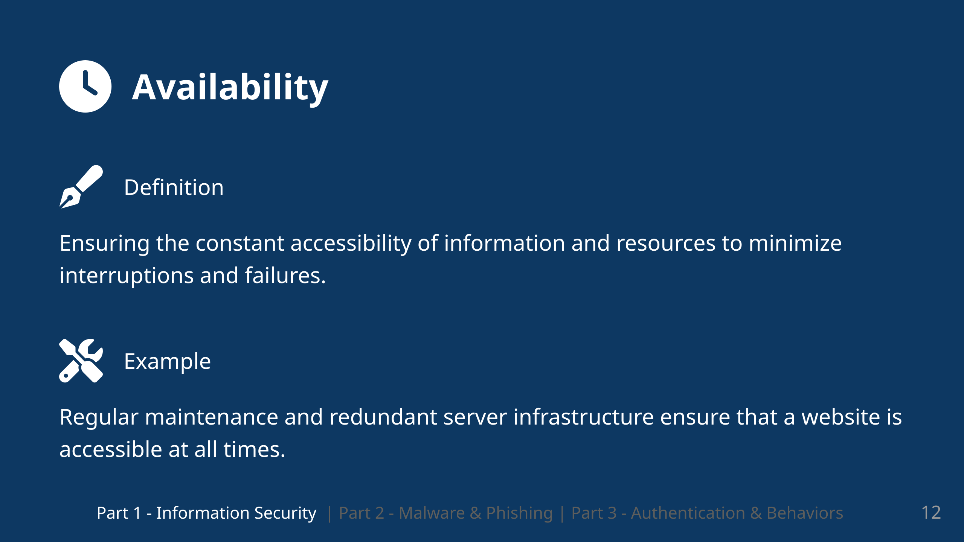
Notes:
Availability of information is based on ensuring that there is constant access to information and resources inside of a certain timeframe. This does not have to be 24/7,but inside of the promised timeframe, we should be able to provide constant access. An example is that we as an IT provider have regular maintenance and redundant infrastructure so that our customers have access to all their services

Slide 14
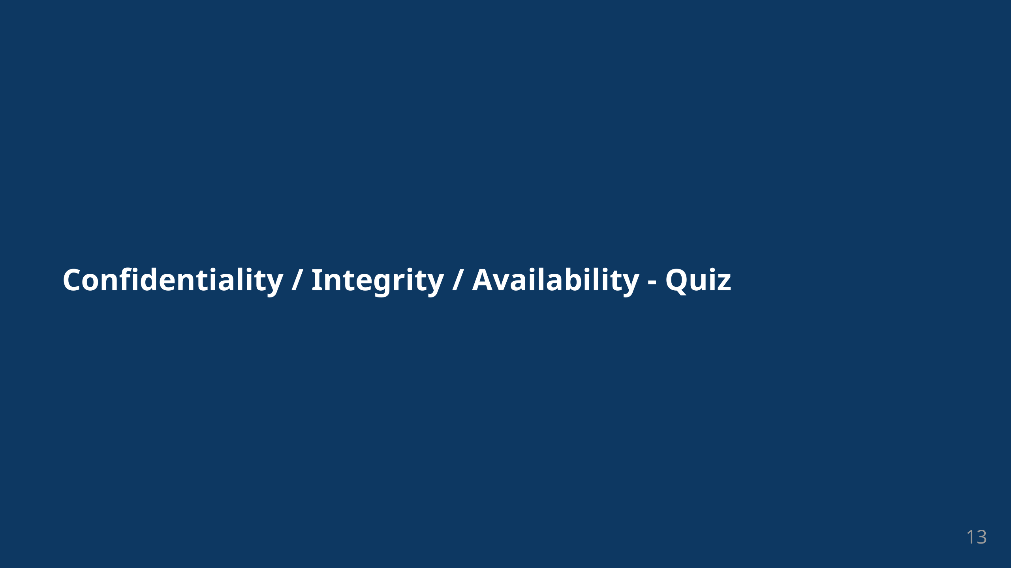
Notes:
# Zoom Poll / Quiz

Slide 15
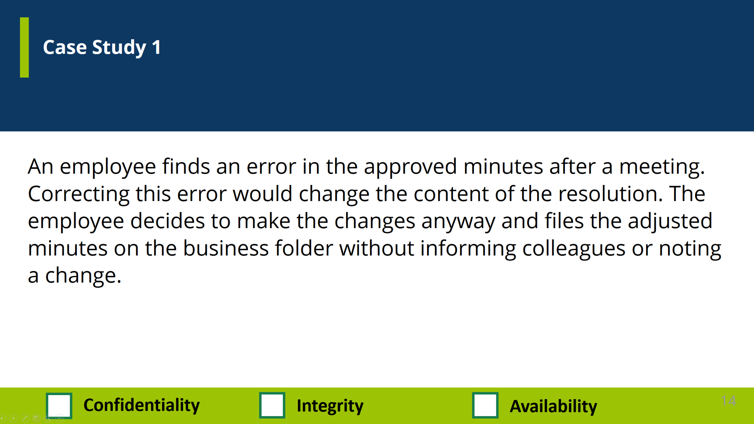
Notes:
# Zoom Poll / Quiz So we will now go through each of the case studies and have look at what the answers would be

Slide 16
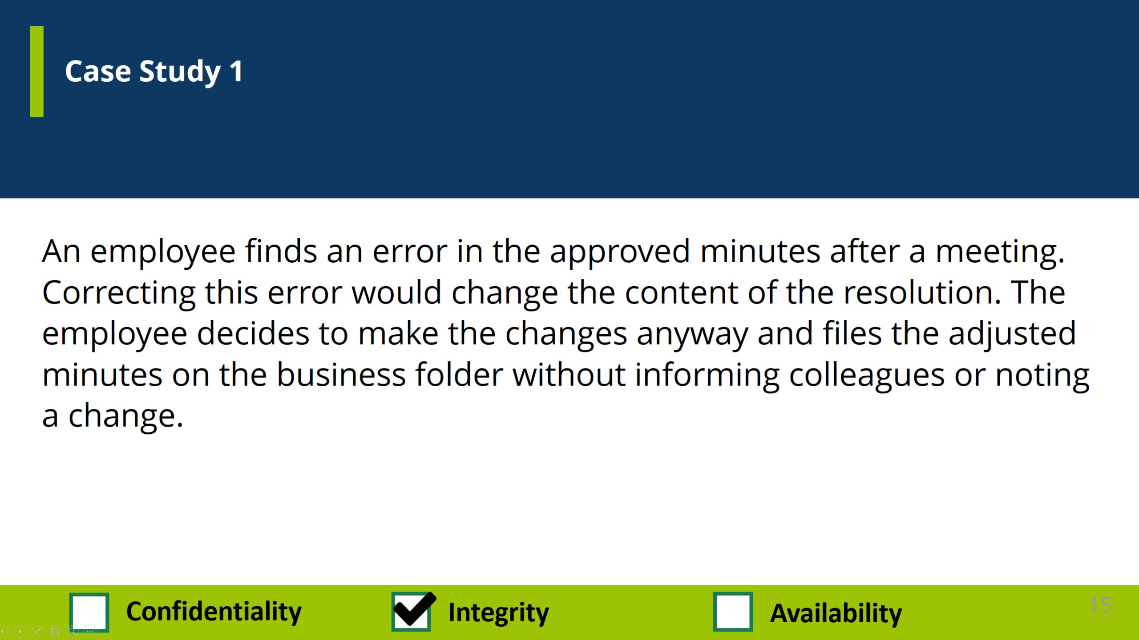

Slide 17
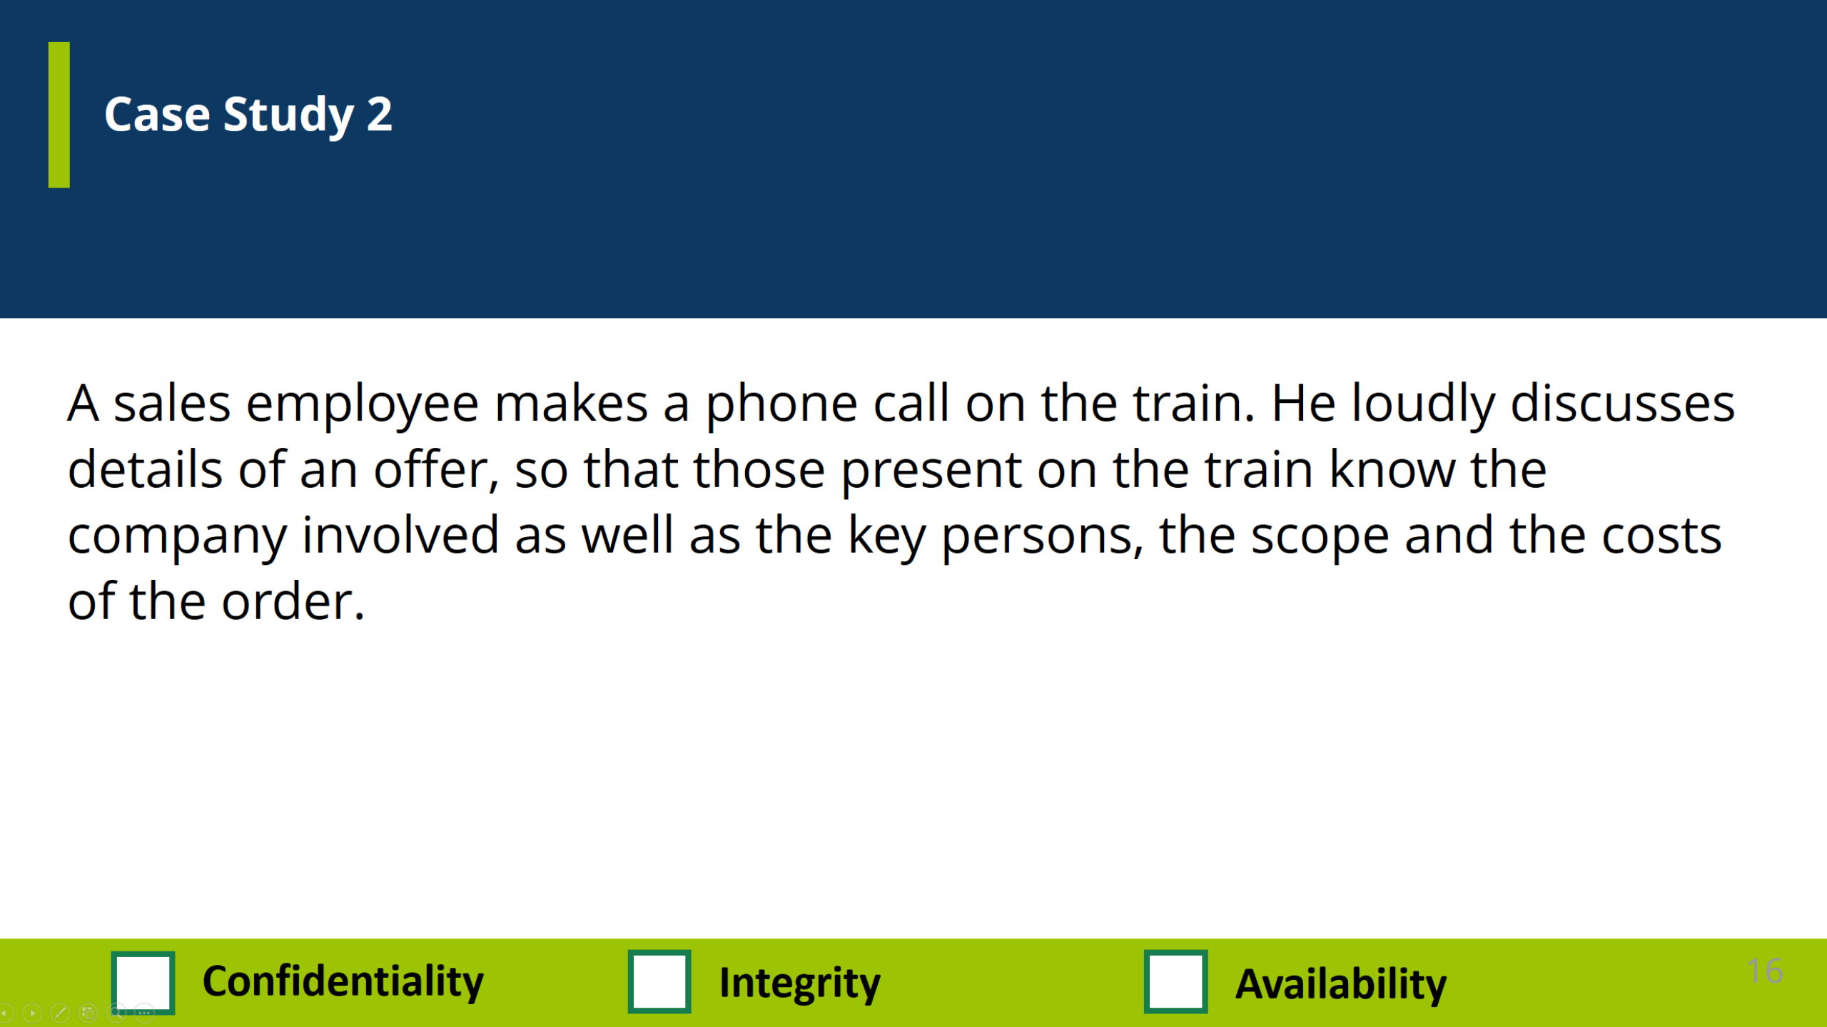

Slide 18
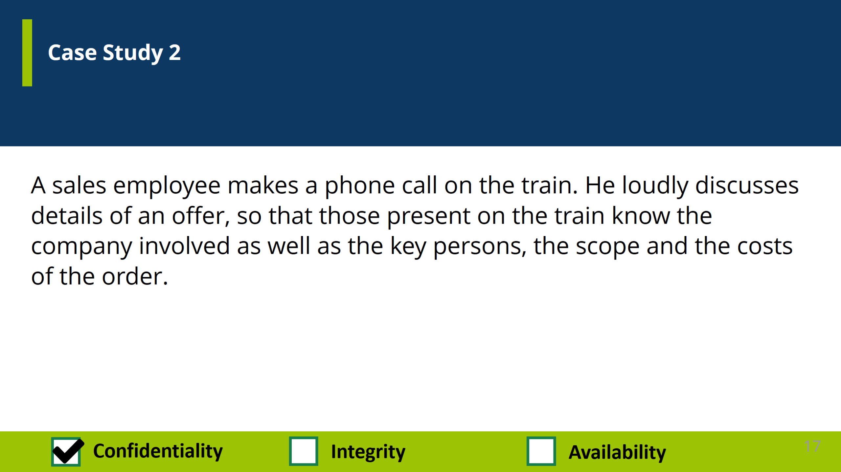

Slide 19
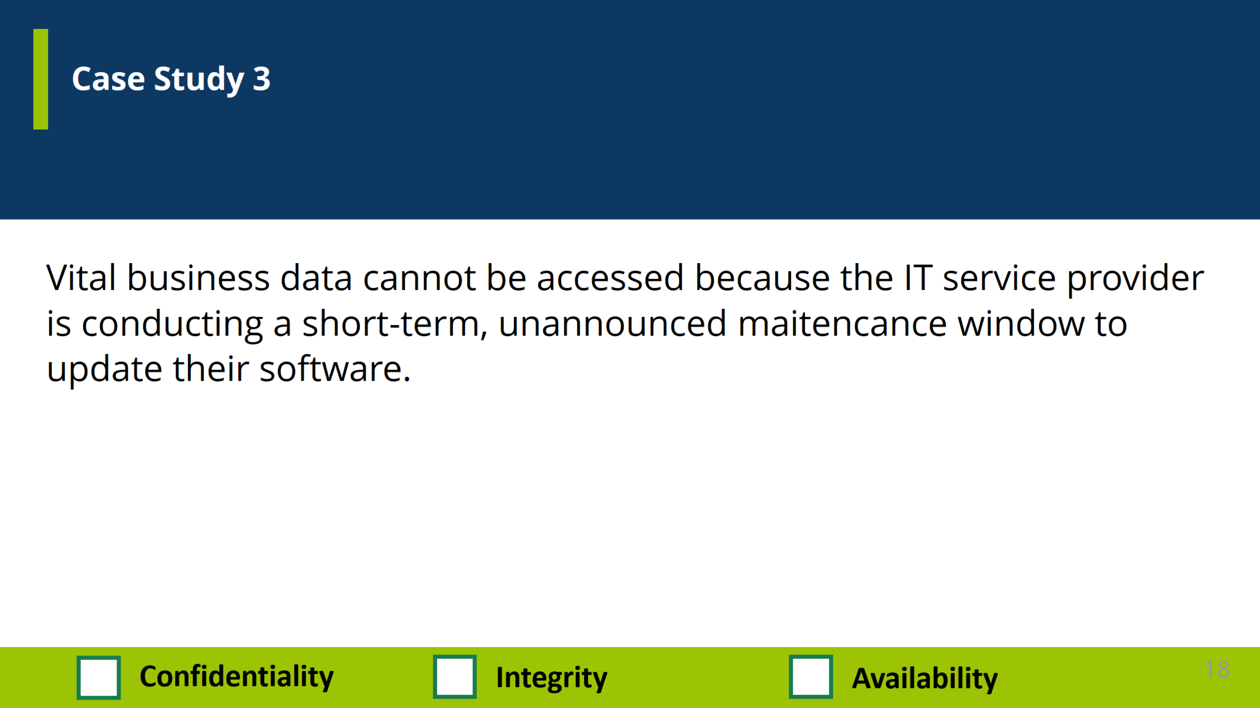

Slide 20
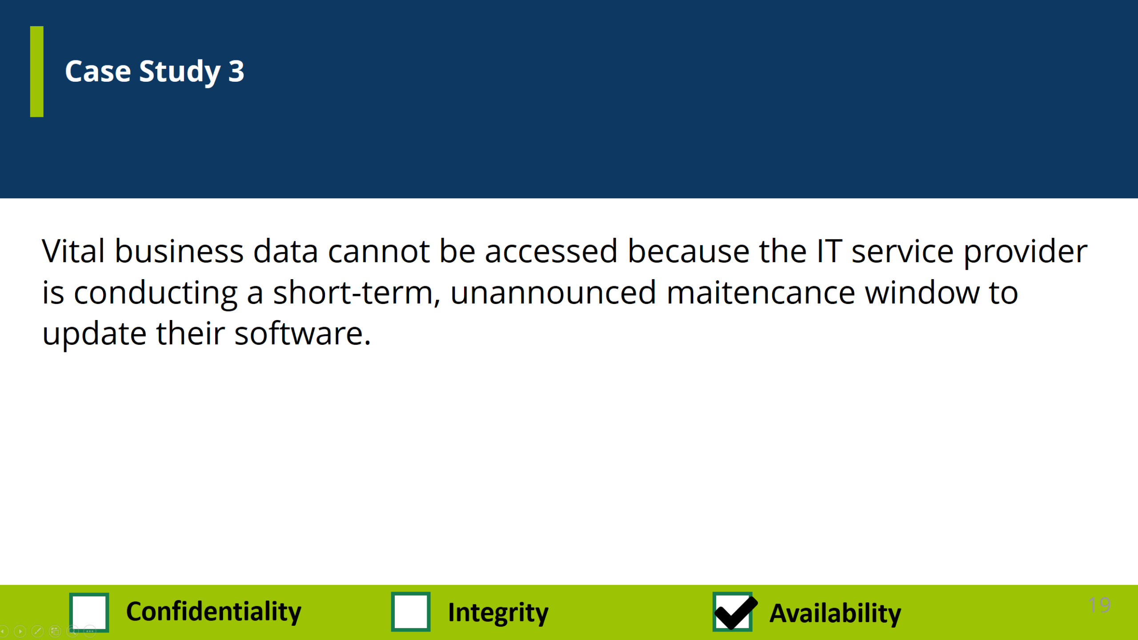

Slide 21
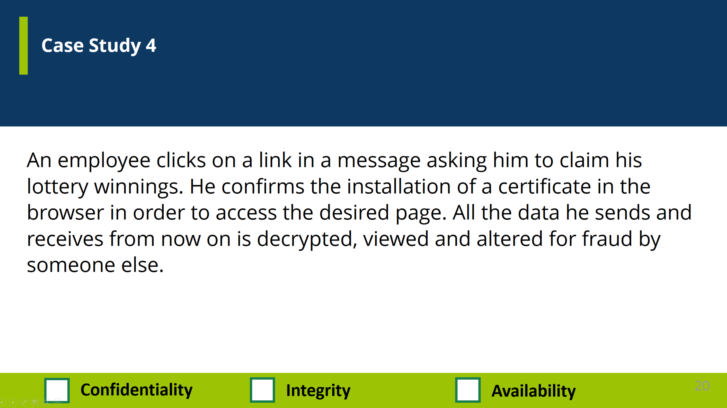

Slide 22
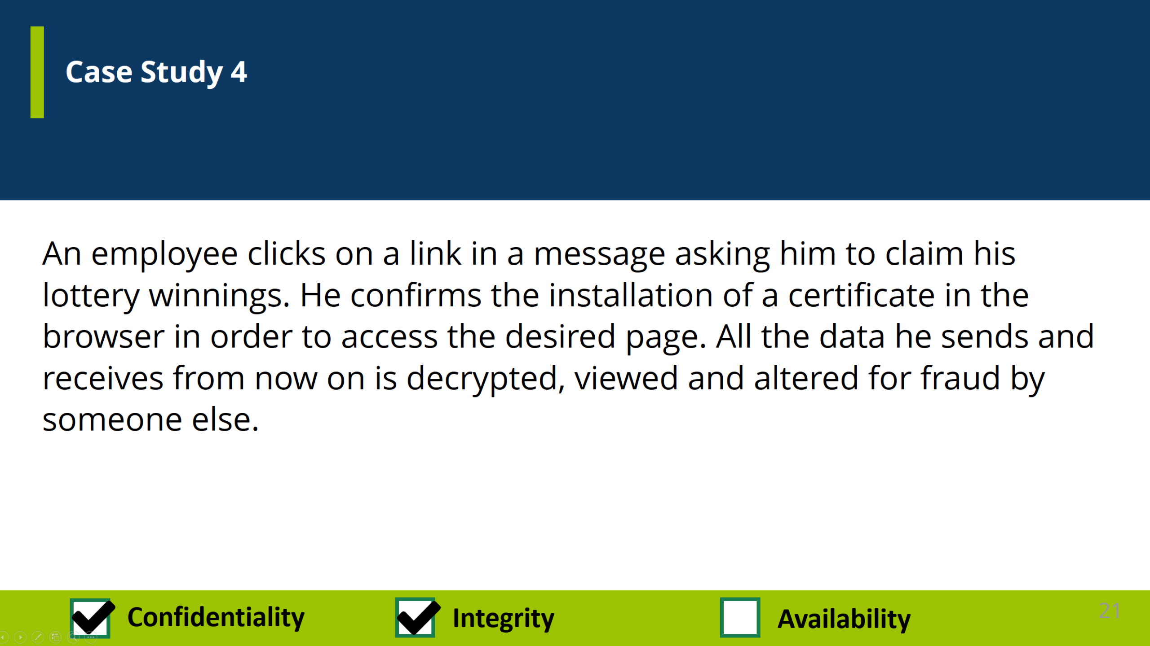

Slide 23
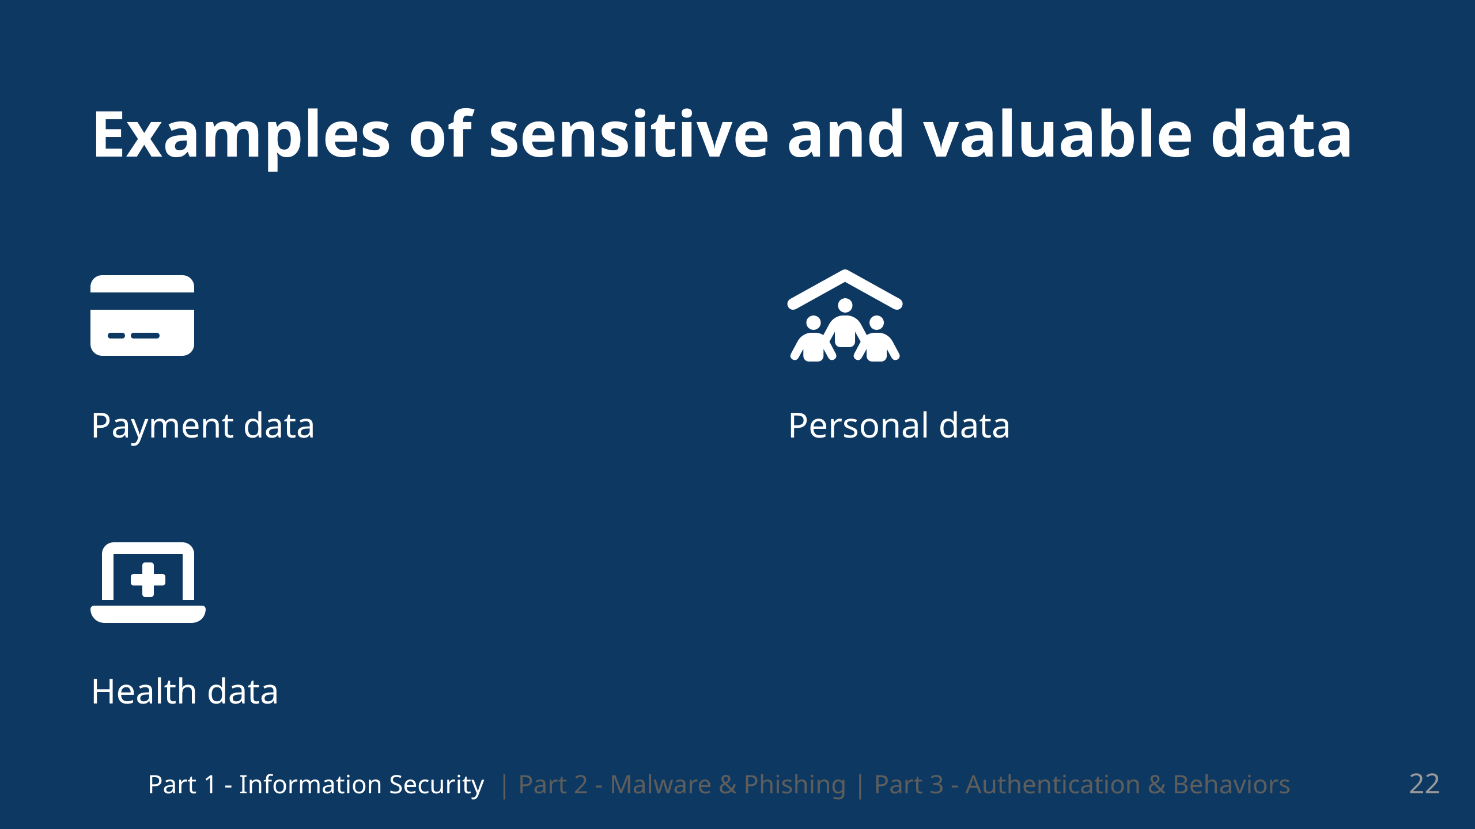
Notes:
So we've established a defintion of Information Security and of it's components. Which i hope you were able to understand Now that we have answered the question of **what** information security is? We will talk about the **why** We have a lot of data nowadays and not only in quantity but the data we have is often also very valuable So this can be for example: - financial data - personal data - health data The value of this data naturally provides an incentive and motivation

Slide 24
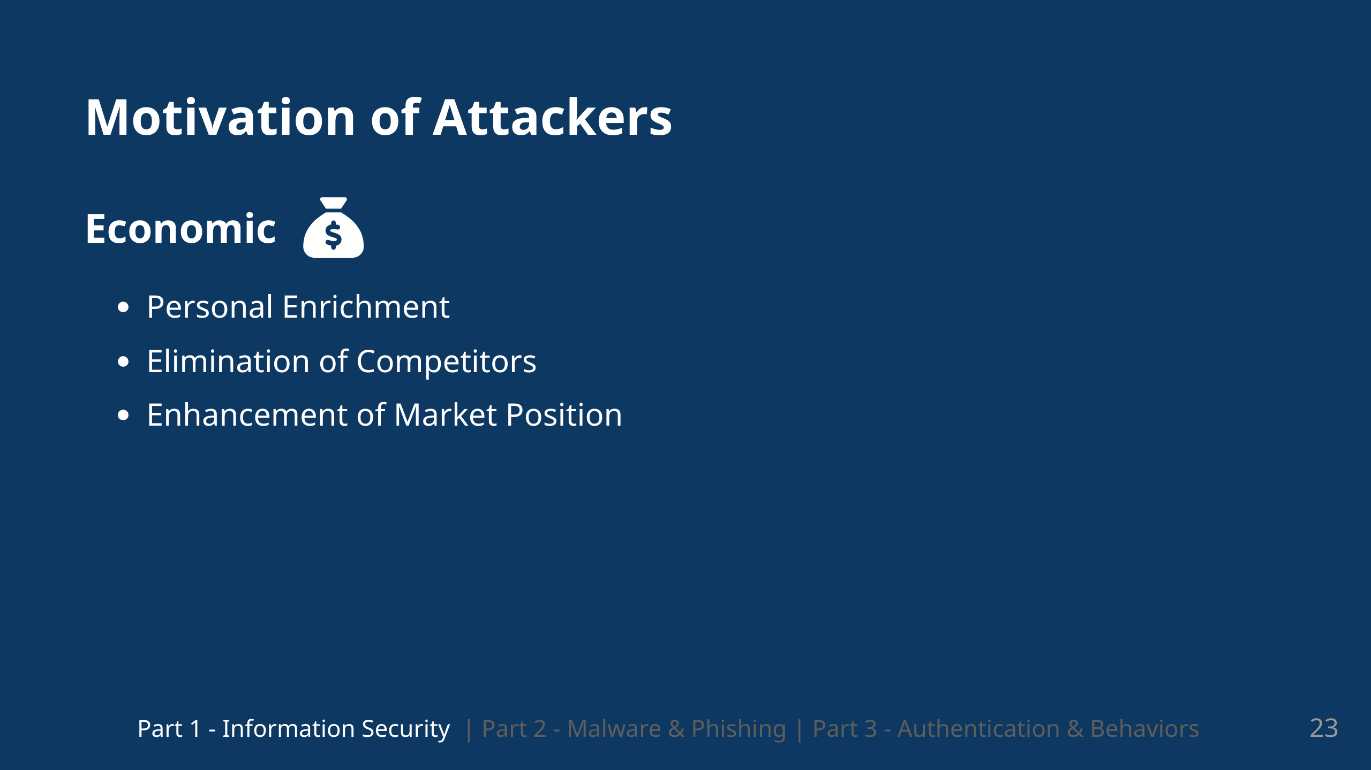
Notes:
So we can defintely understand that there many incentives to conduct and attack We have the economical motivators And then especially with social media as well have political motivations and personal motivations

Slide 25
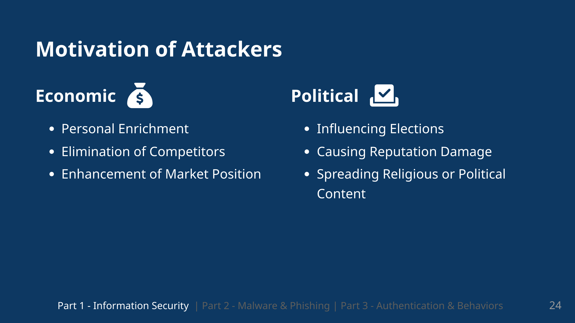

Slide 26
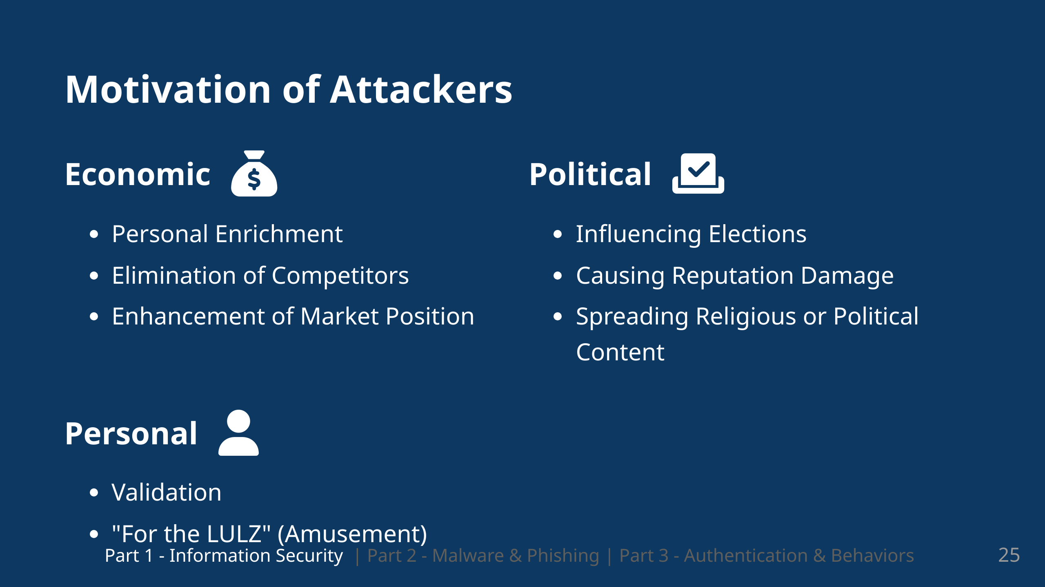
Notes:
So we can defintely understand that there many incentives to conduct and attack We have the economical motivators And then especially with social media as well have political motivations and personal motivations

Slide 27
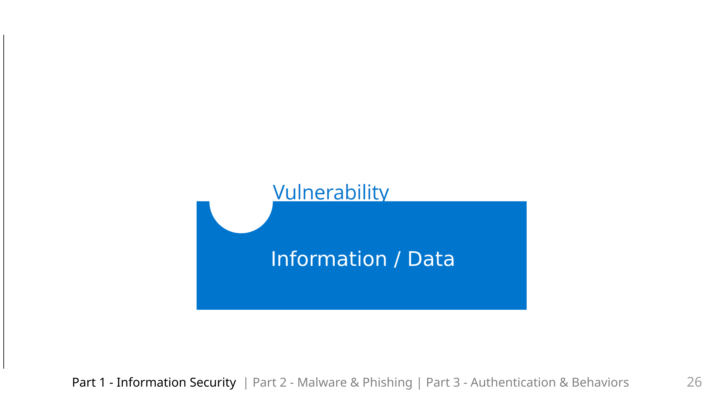
Notes:
So these attackers have their motivations and we have our information / our data. The attackers try find vulnerabilities which they can exploit

Slide 28
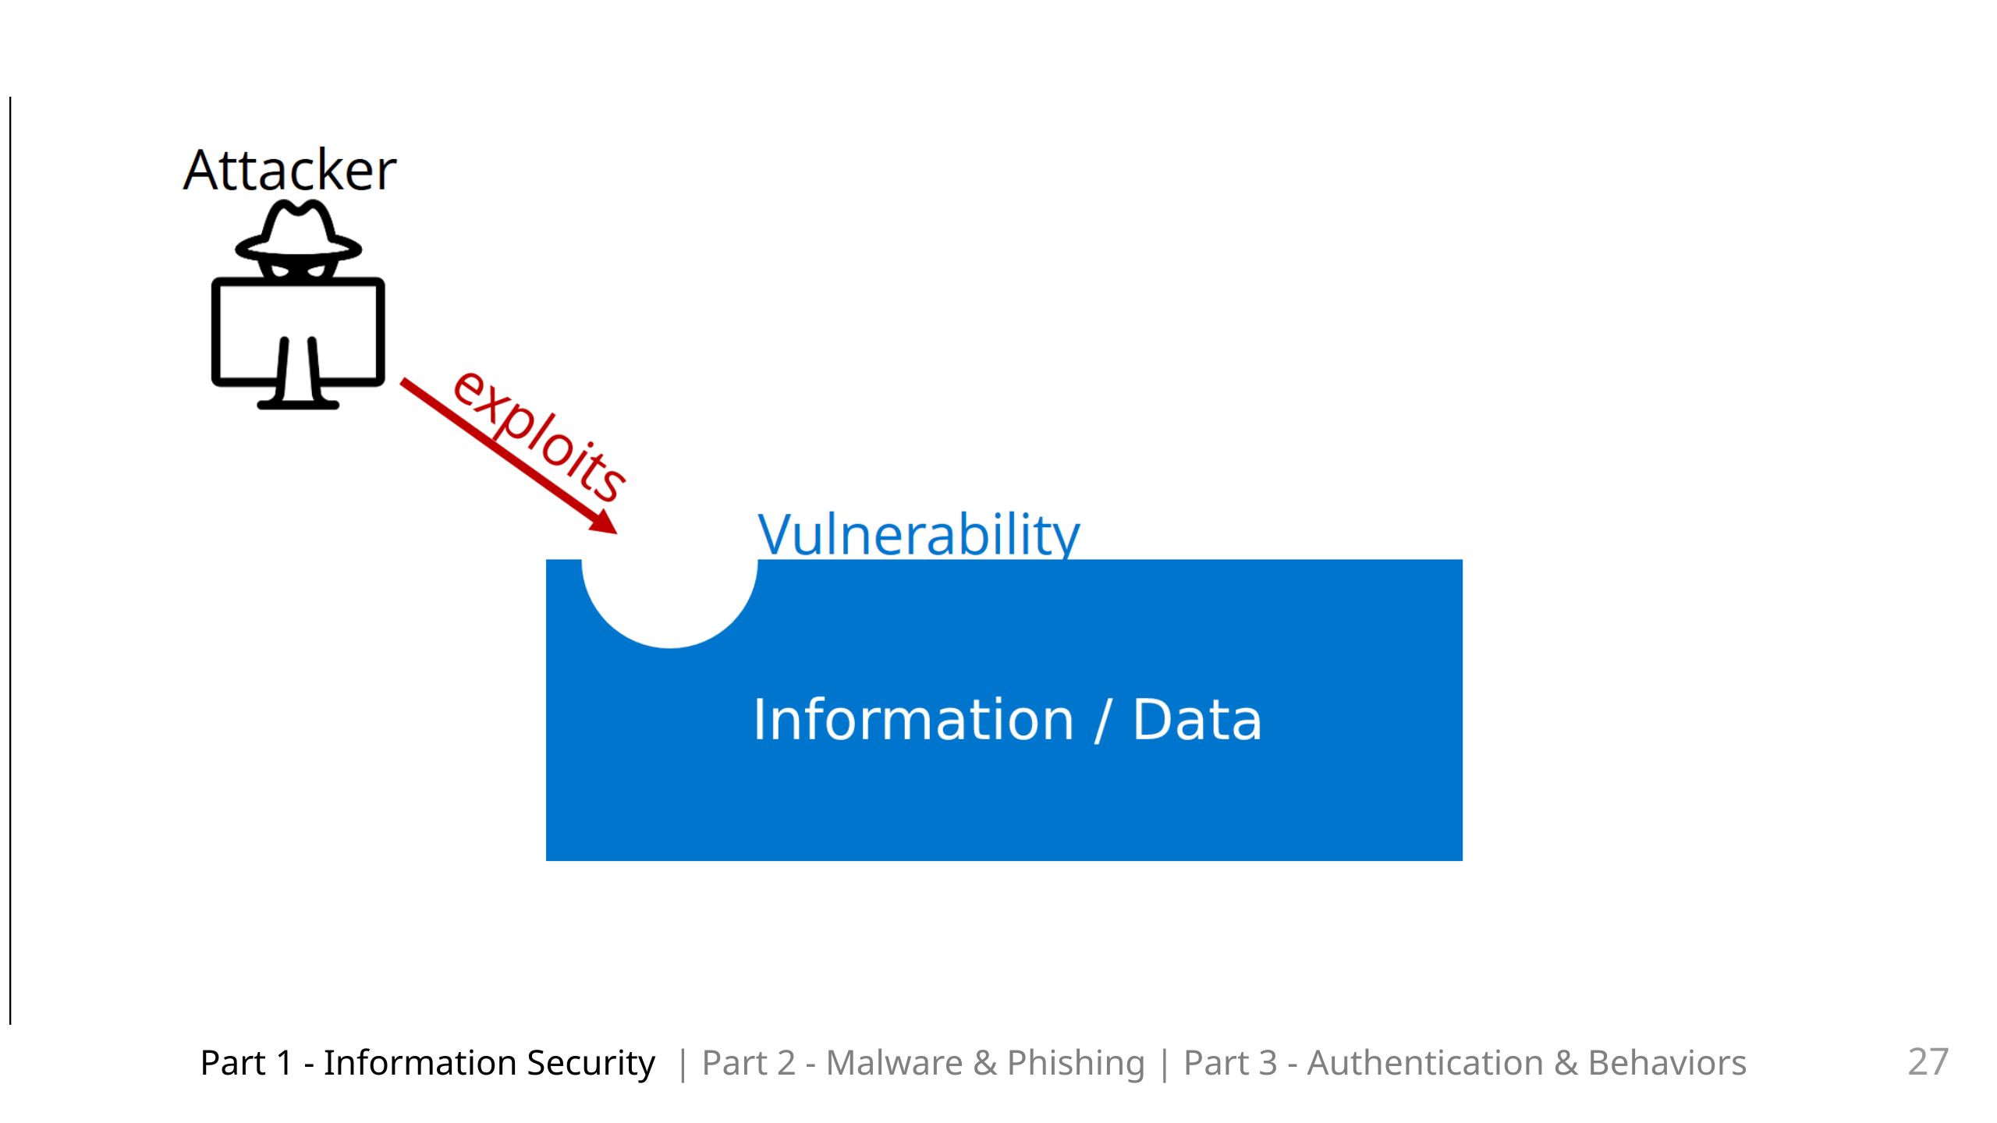
Notes:
So these attackers have their motivations and we have our information / our data. The attackers try find vulnerabilities which they can exploit

Slide 29
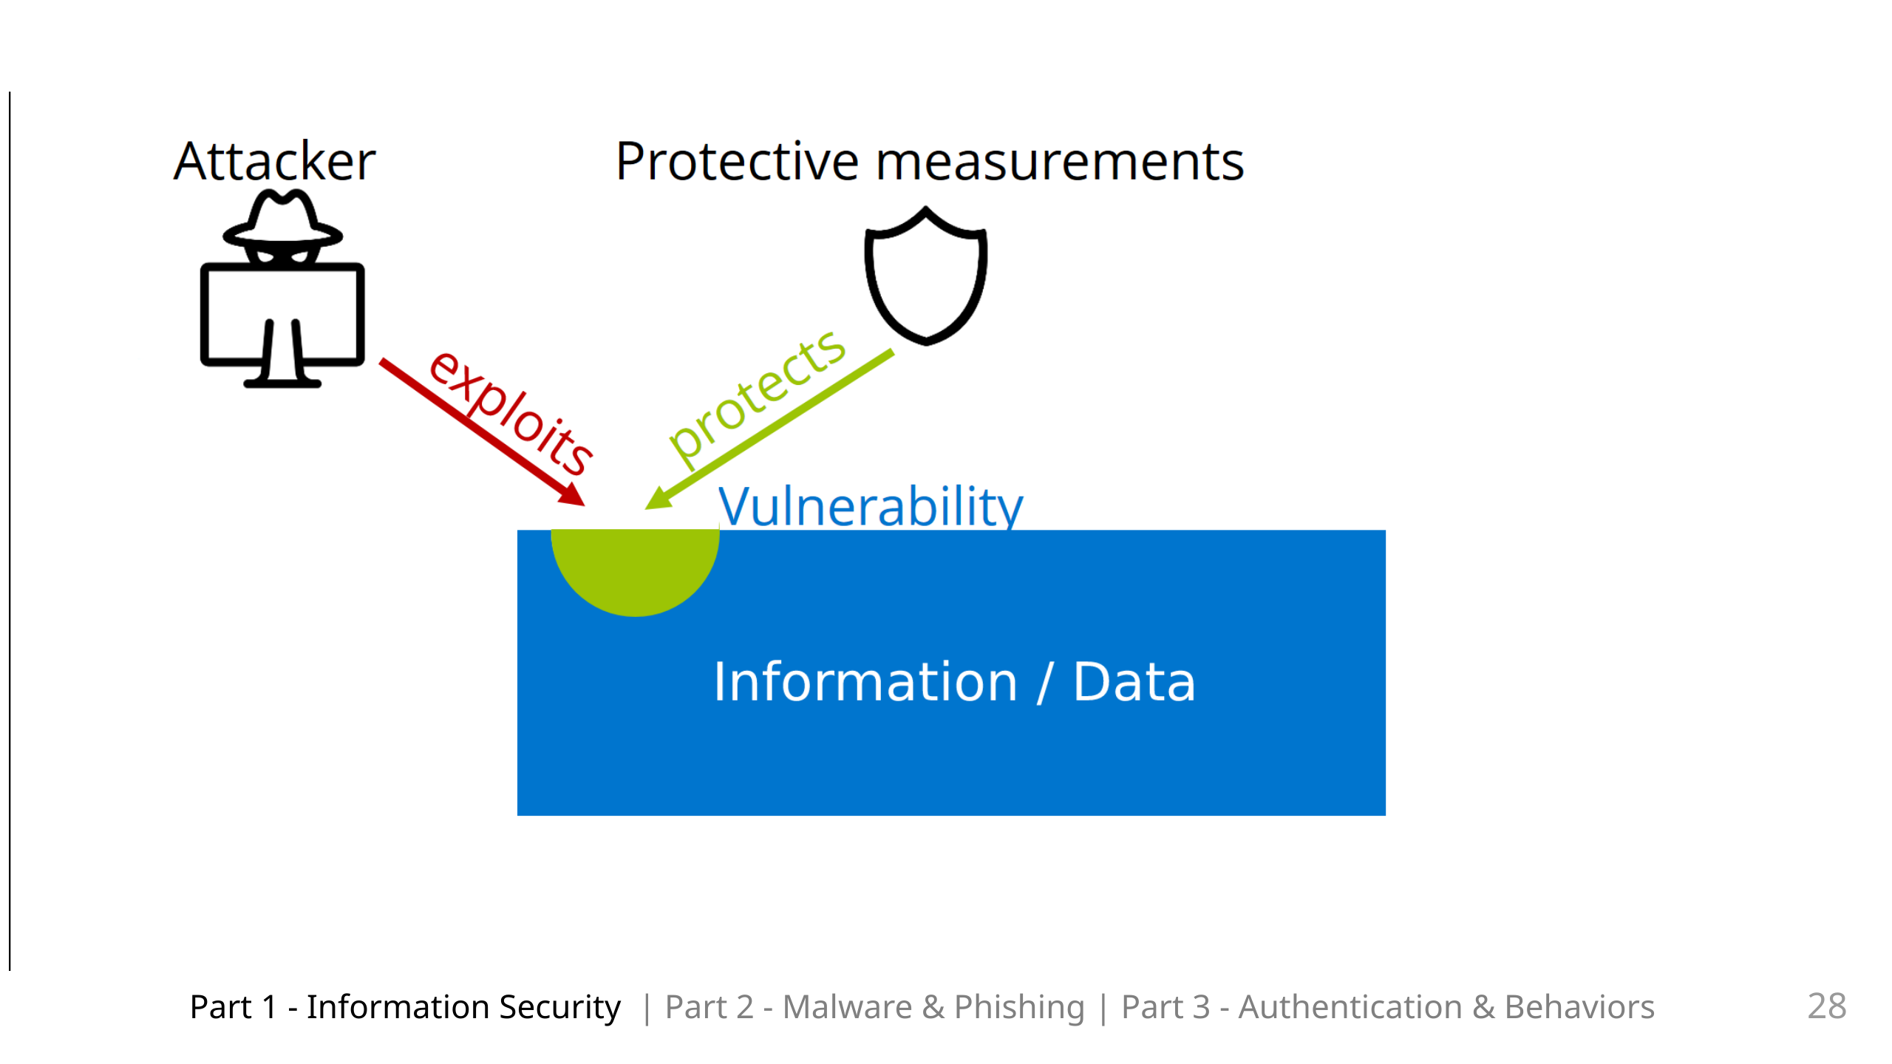
Notes:
We then take protective measurements to patch or to protect these vulnerabilities.

Slide 30
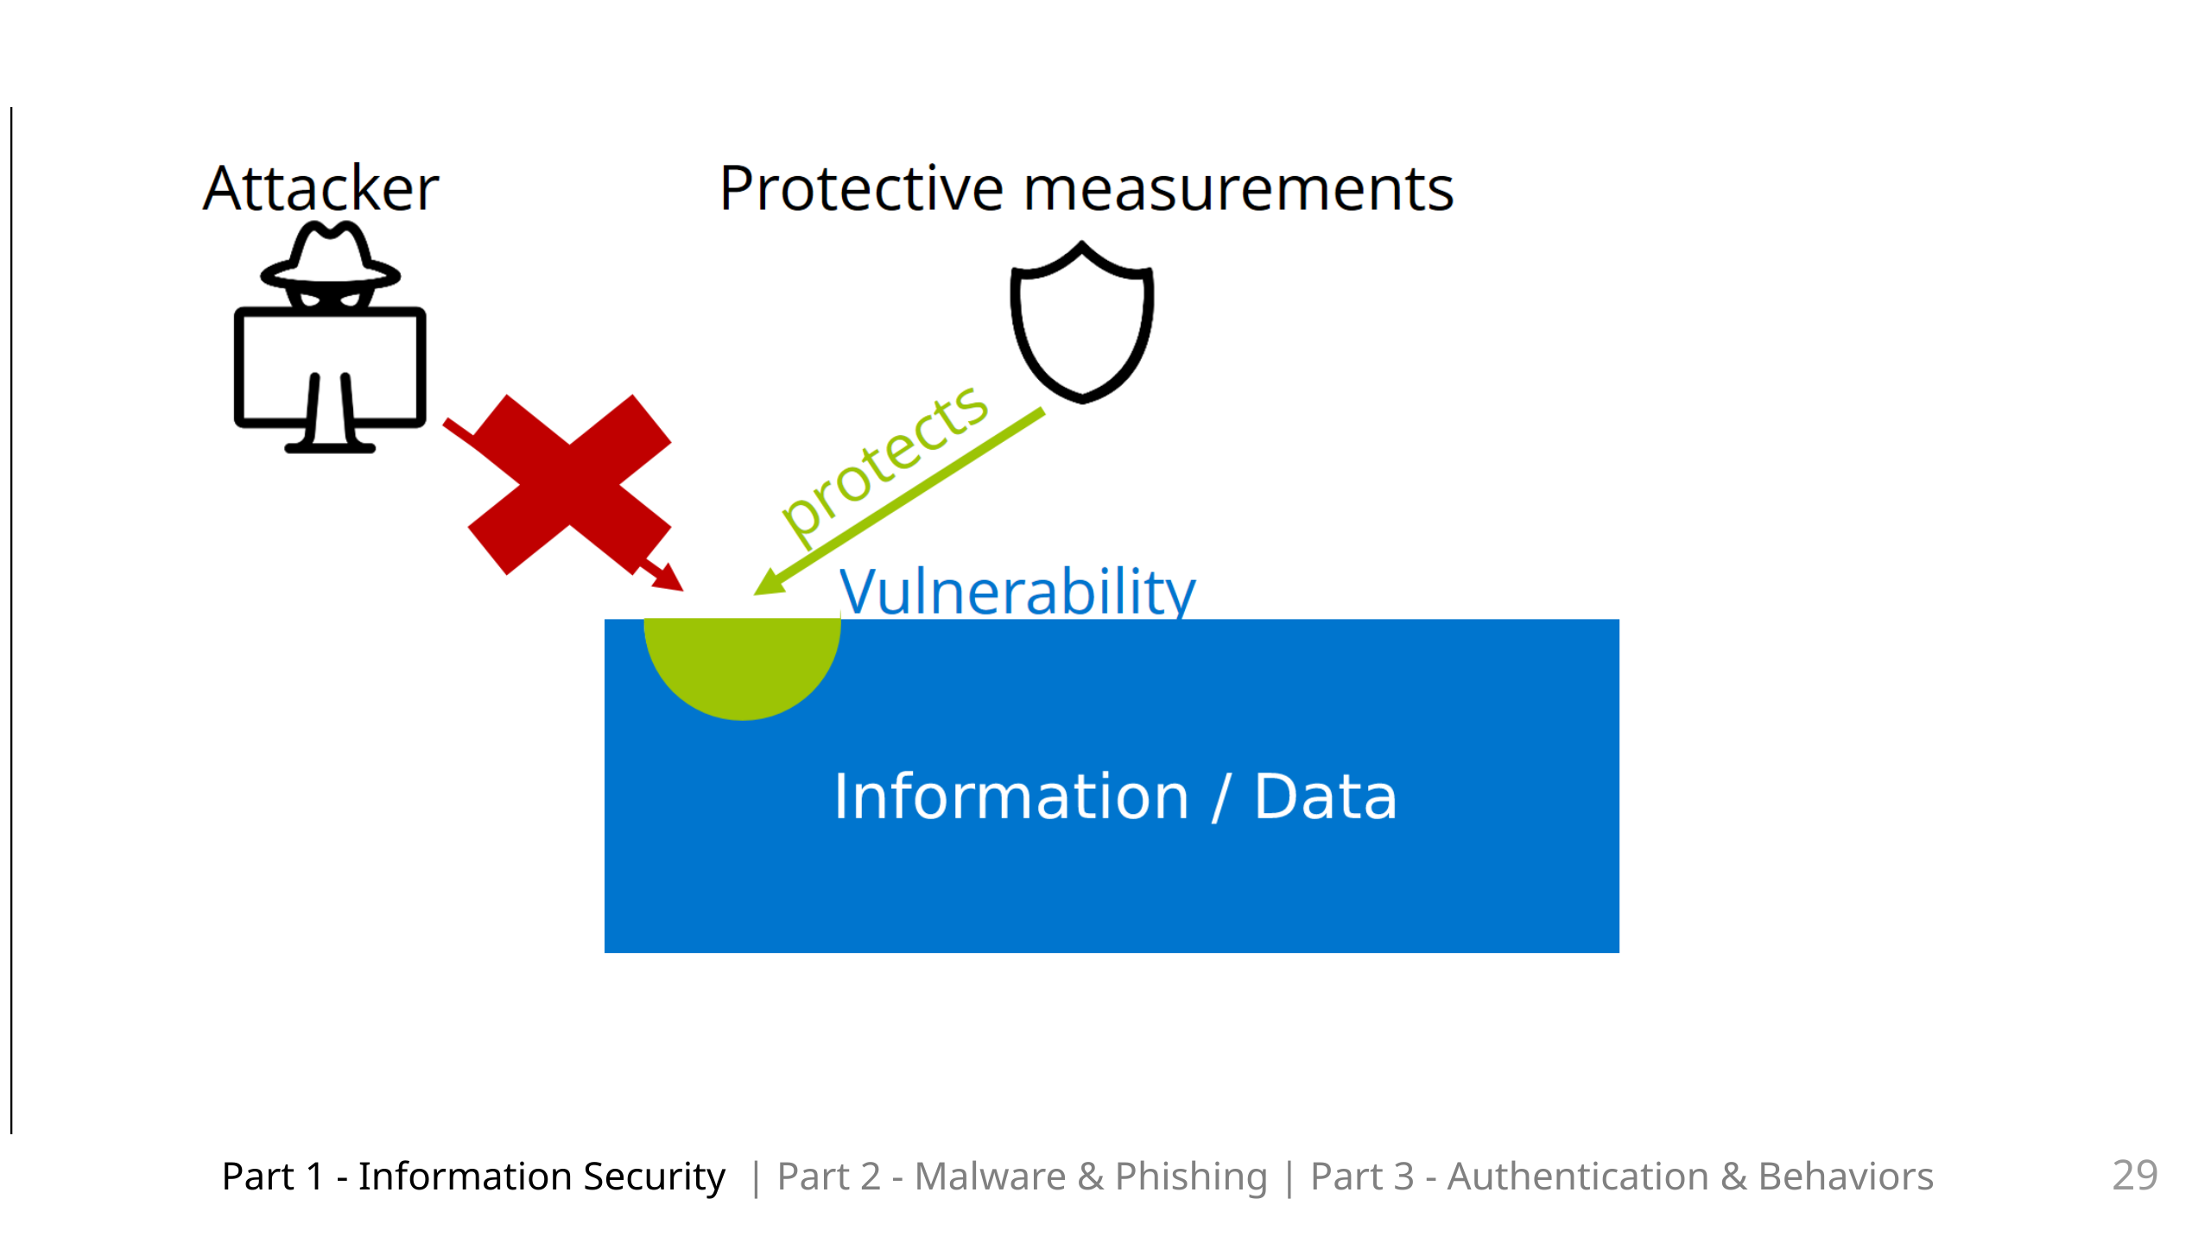
Notes:
This then hinders further attacks. For the moment.But this is a cylical process. We continuously want to ensure that we have the correct protective measurements applied. What should be noted is that we try to deploy protective measurements proportionally, based on the value of our information / data. And to help us with this we have classifications

Slide 31
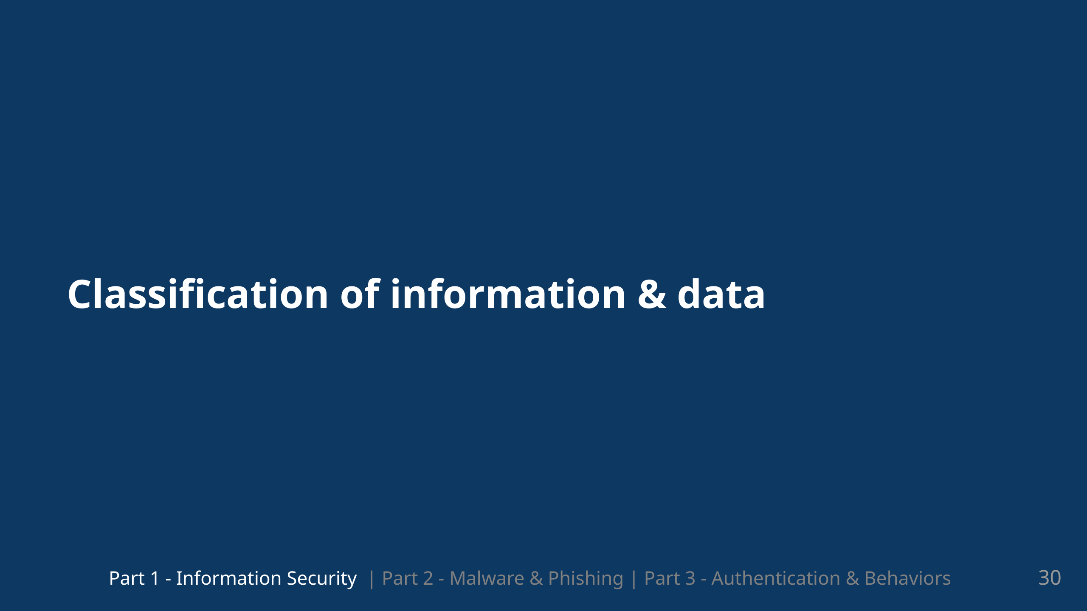
Notes:
It helps us group data based on different factors

Slide 32
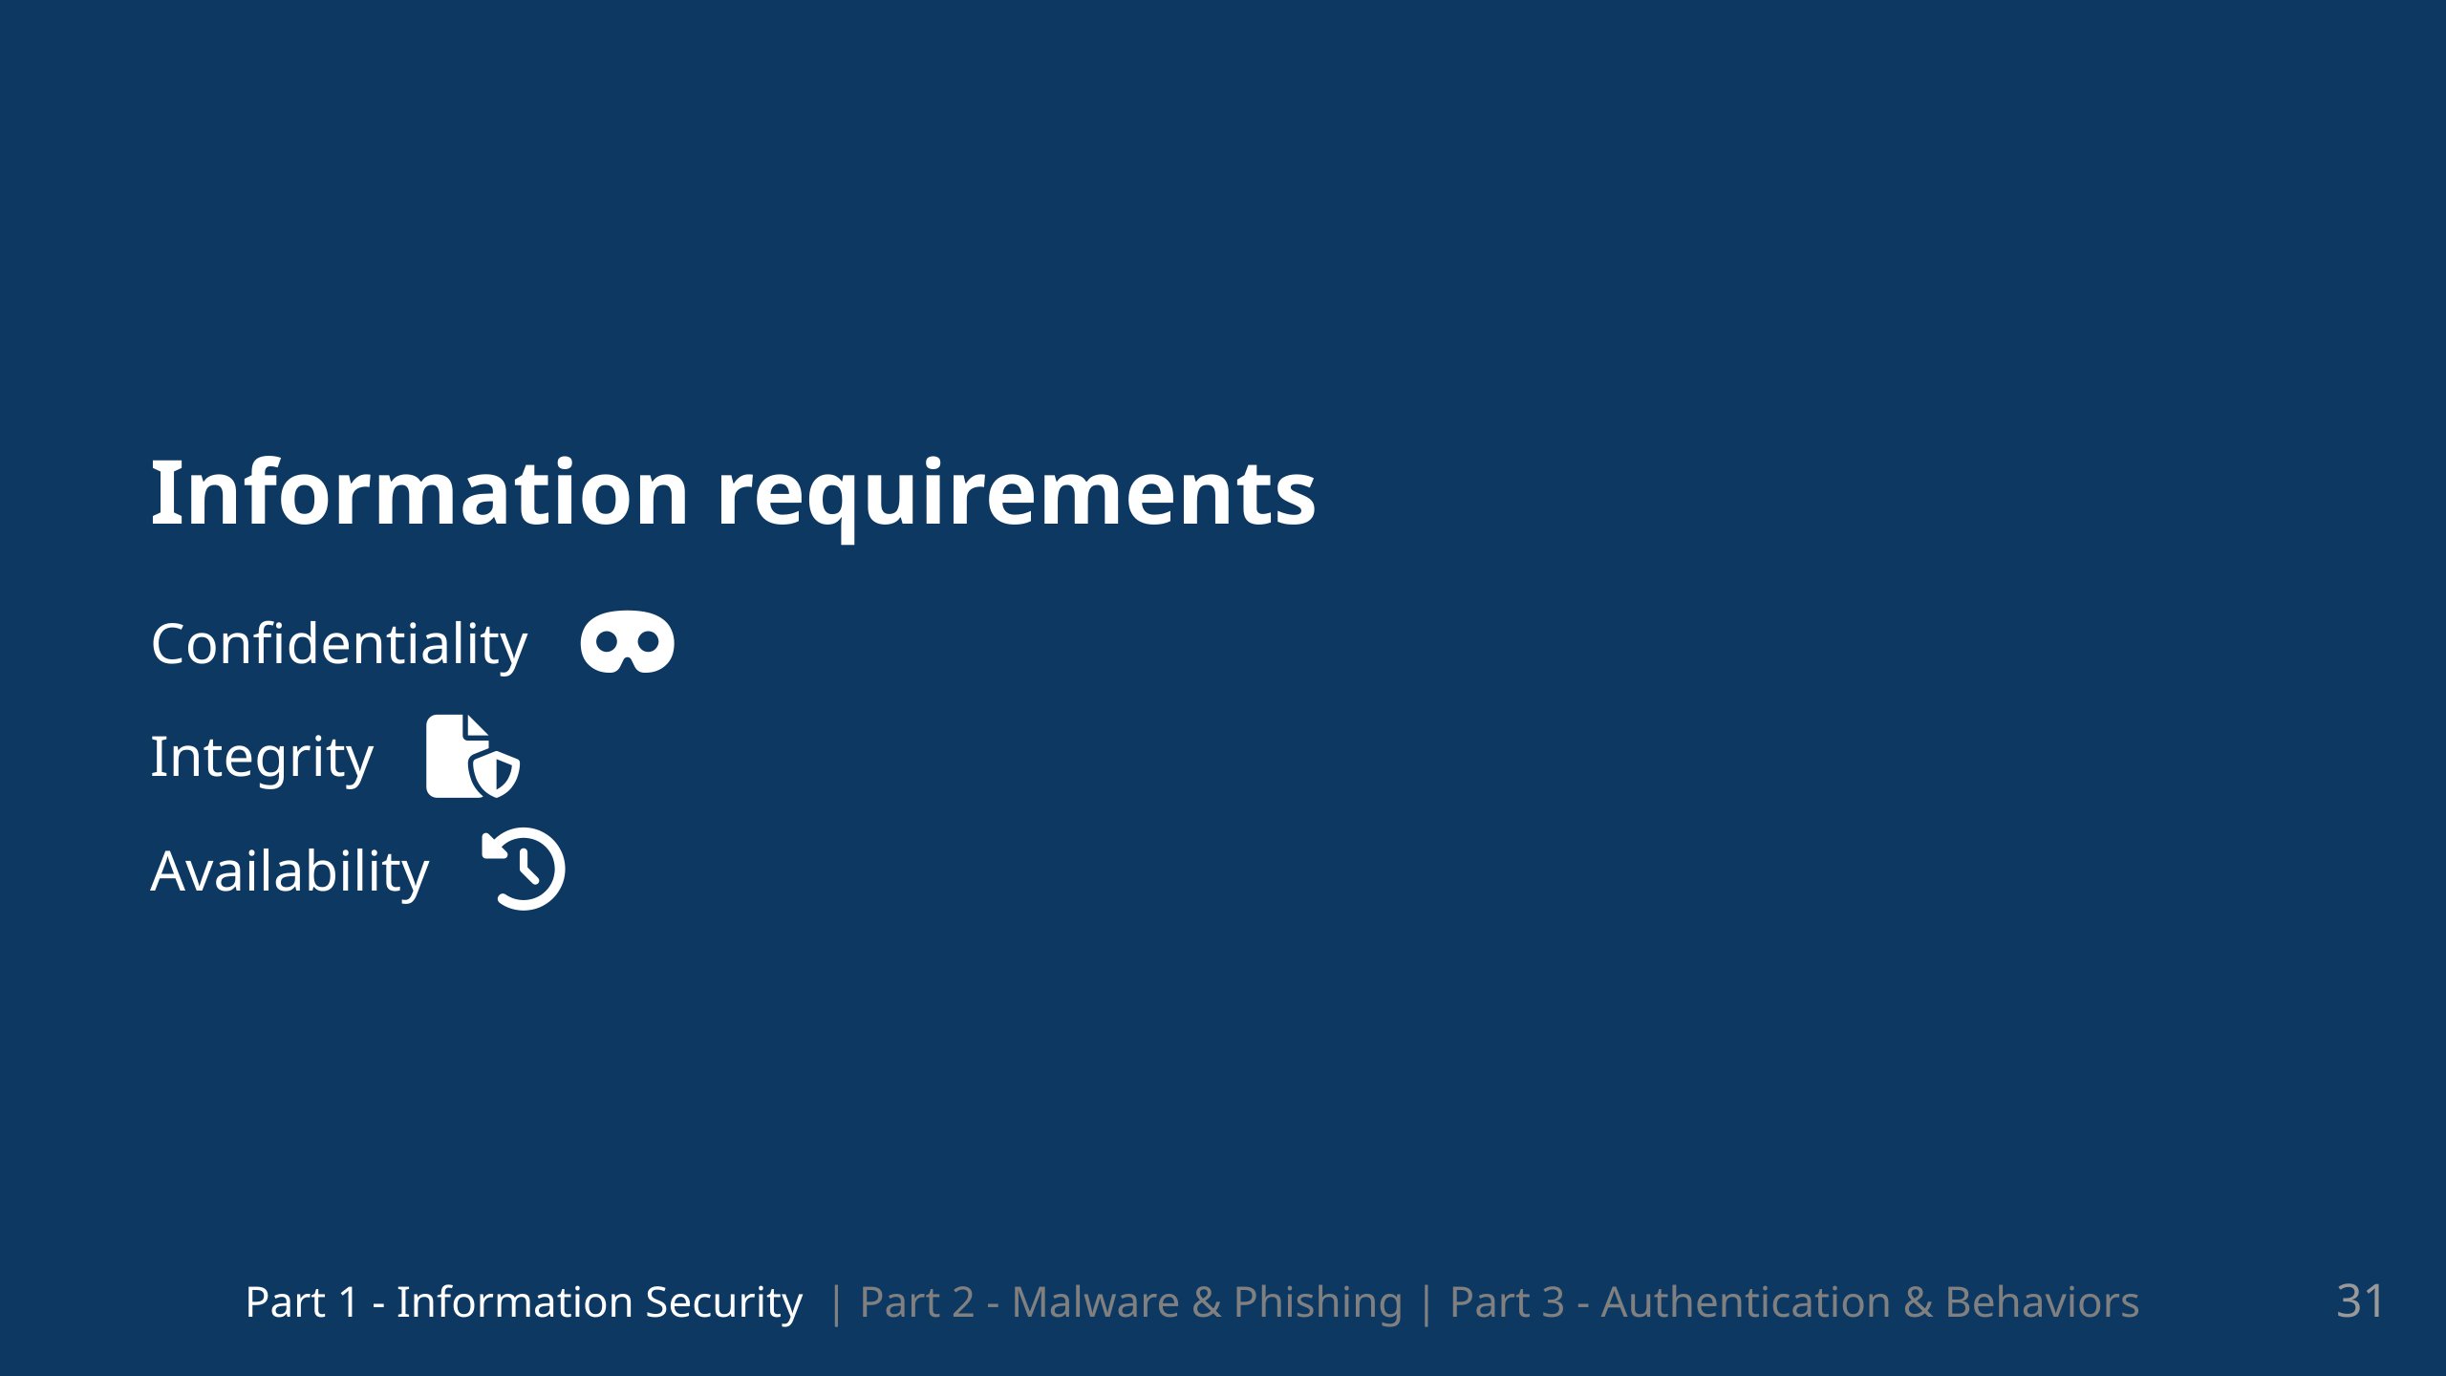
Notes:
And once again we meet our lovely trio / triad CIA We can apply these properties to help us define our requirements when it comes to classification

Slide 33
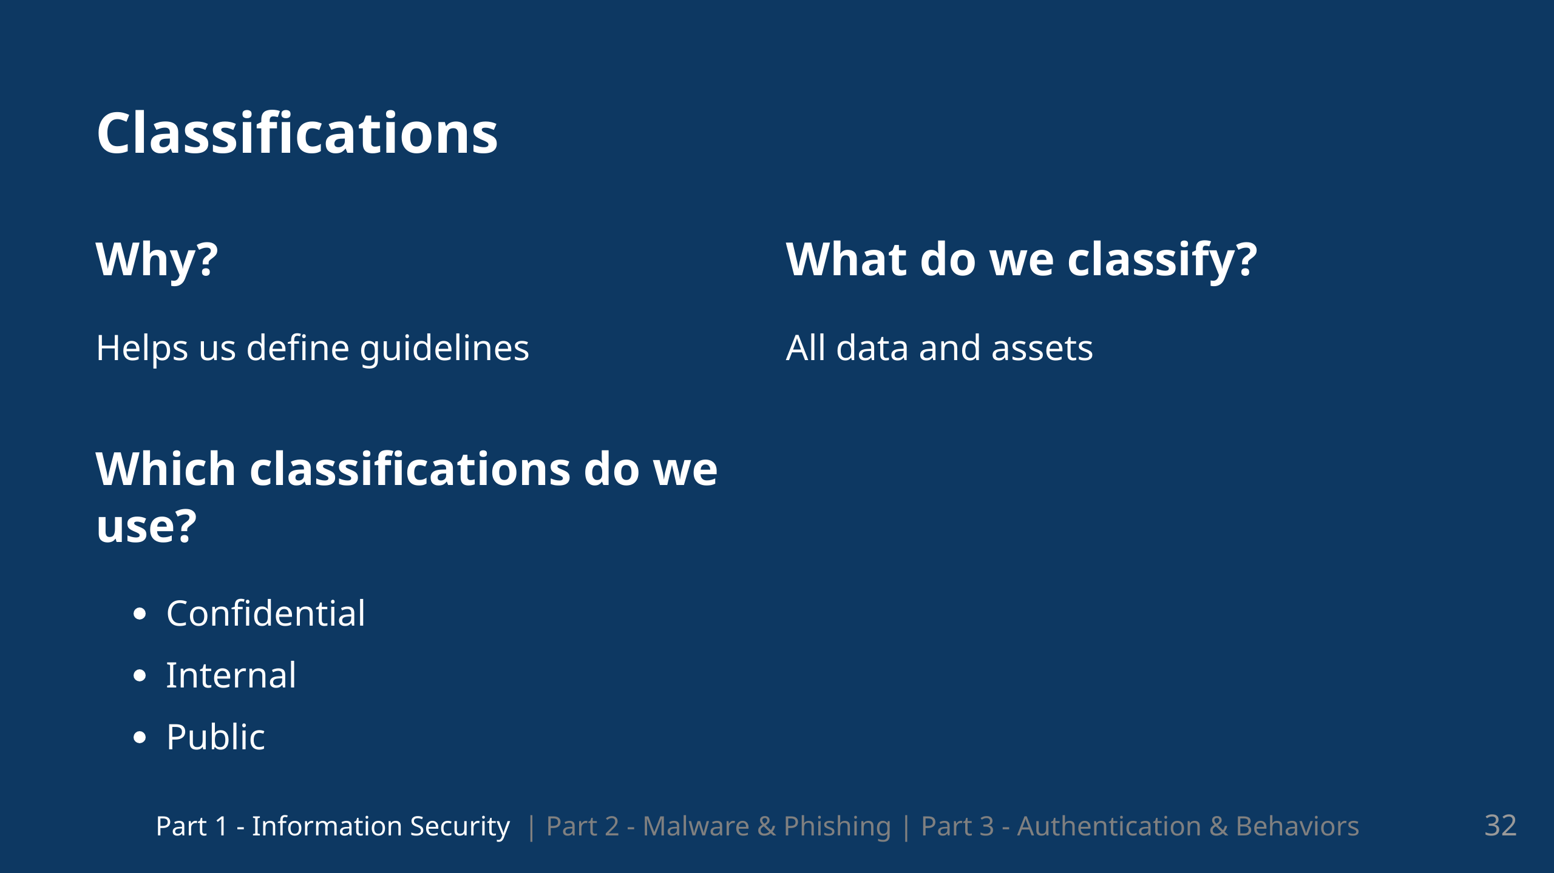
Notes:
Today we will focus on 3 classifications according to ISO-Standards: Confidential Internal & Public. There is also the classification top secret, but that is mainly used in pharmaceutical companies and the military industy so we will not discuss that today.

Slide 34
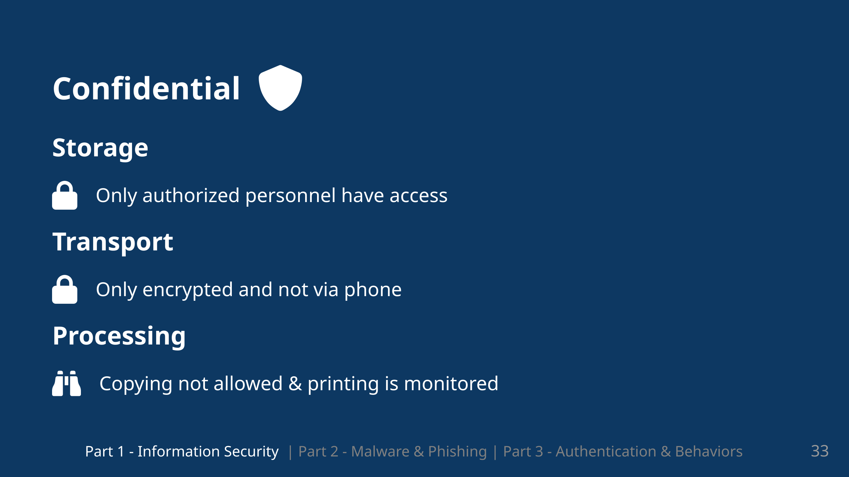
Notes:
So we have three areas which we will look at which is Storage, transport and processing of data. And this is based on our classifcation so for confidential:... Printing is allowed but copying is not. And when we print, the printing should be monitored.

Slide 35
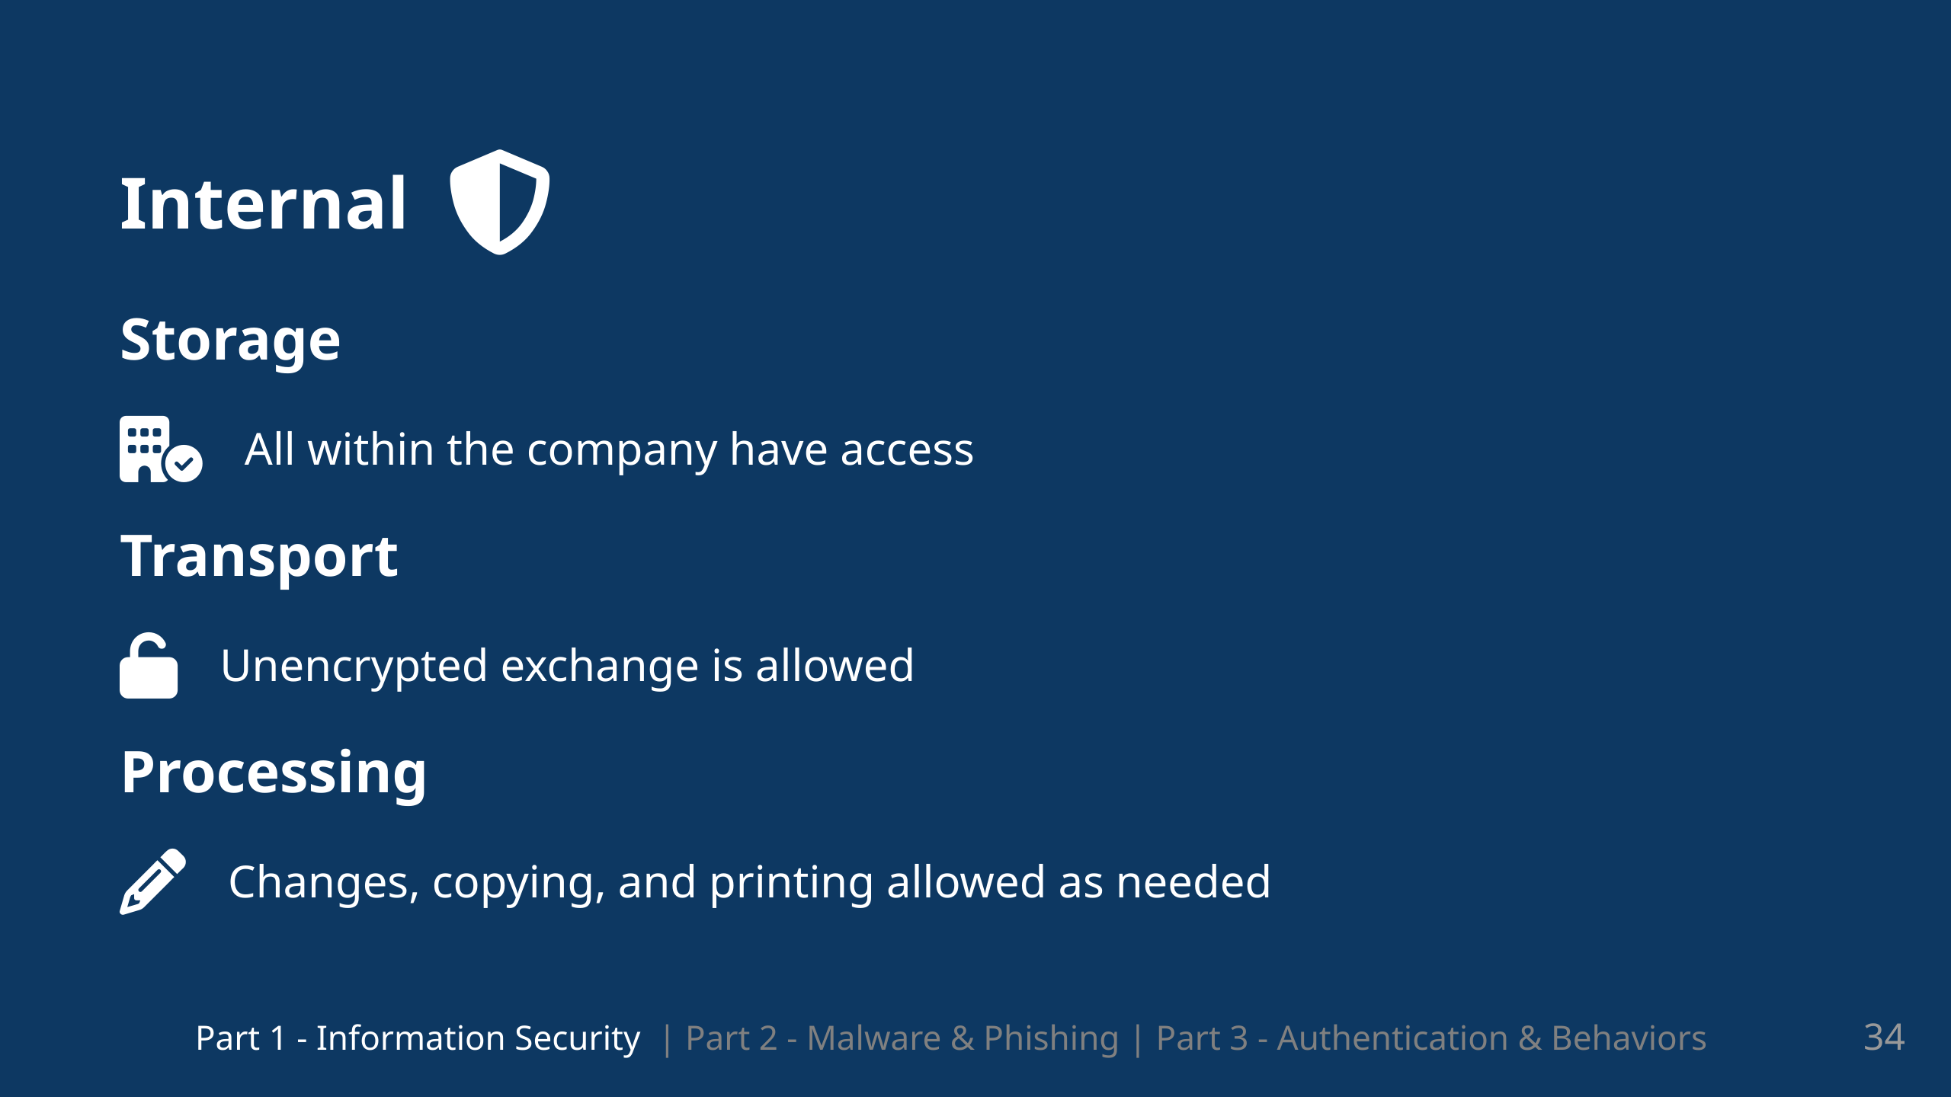
Notes:
Transport: Unenencrypted and phone calls are allowed but not in public spaces. And to note for processing is that it should be comprehensible and traceable

Slide 36
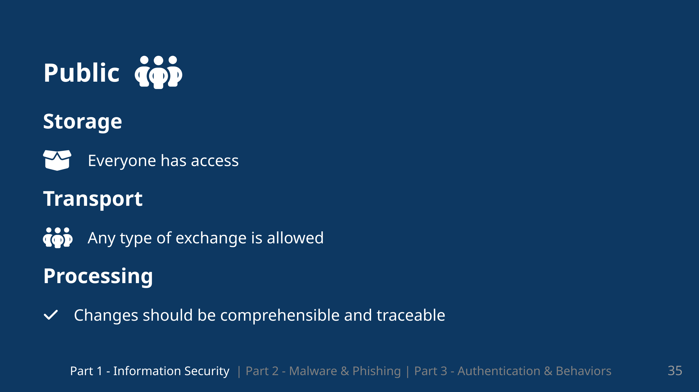

Slide 37
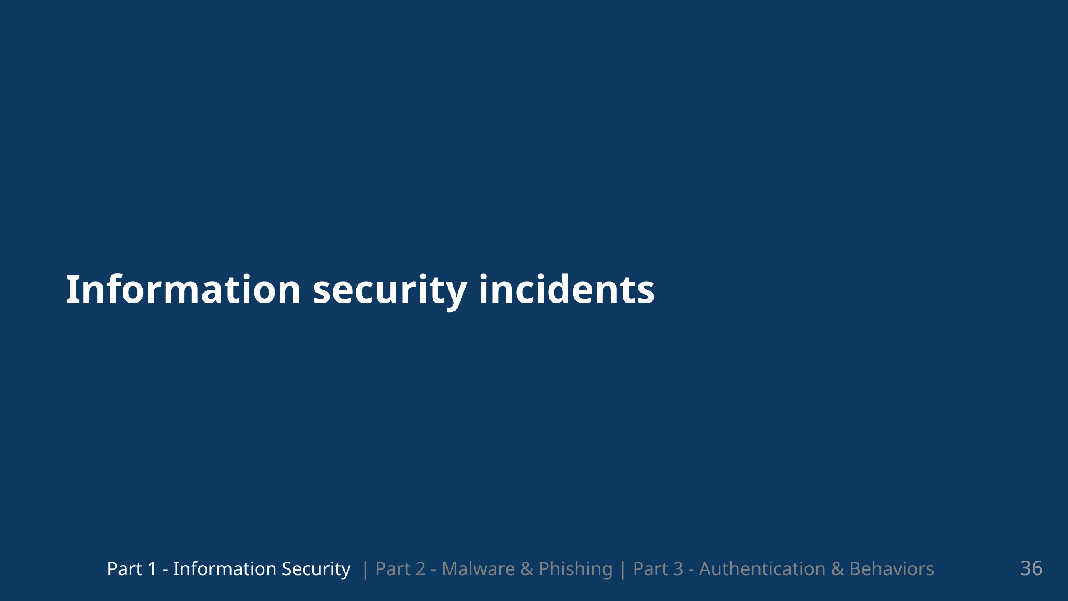
Notes:
So what happens when we are actually attacked and have a security incident?

Slide 38
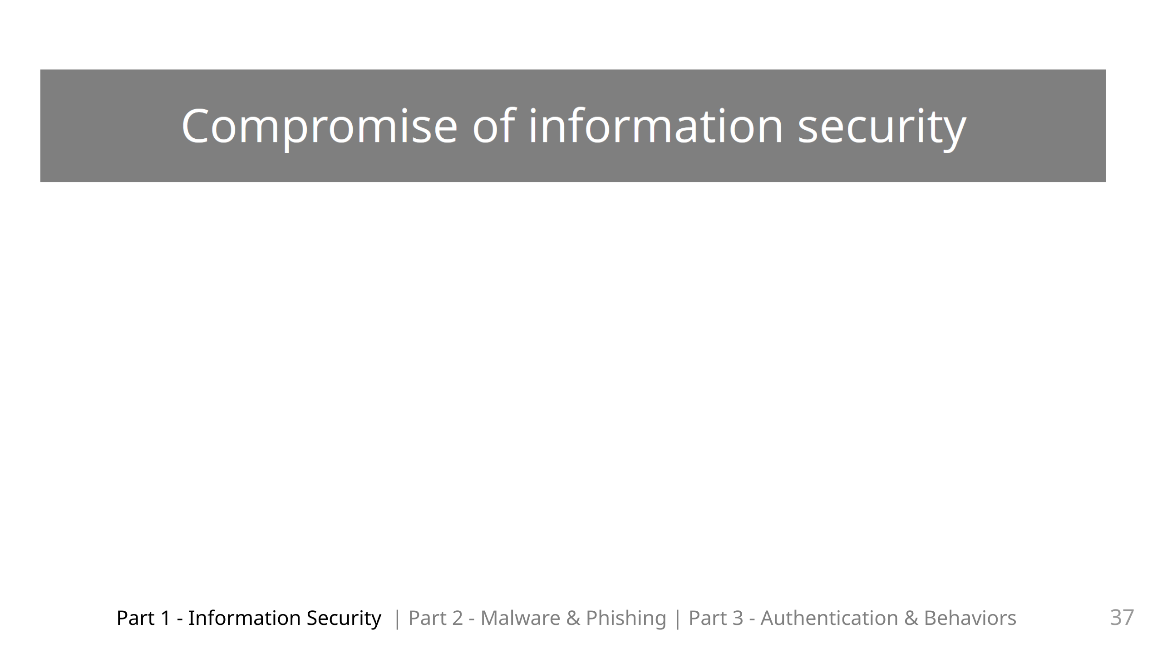
Notes:
We can define a compromise of information security based on our CIA triad / our security goals. It can be a compromise of one area or multiple of these three areas at the same time

Slide 39
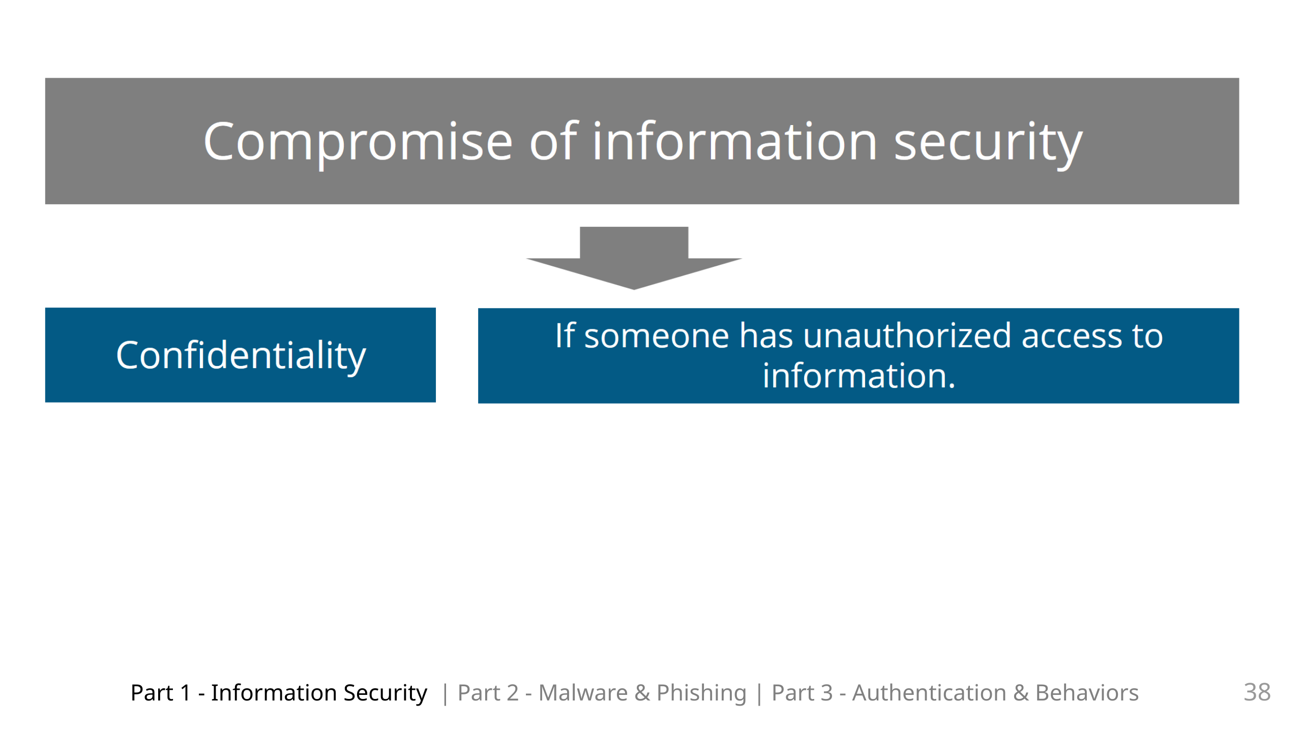

Slide 40
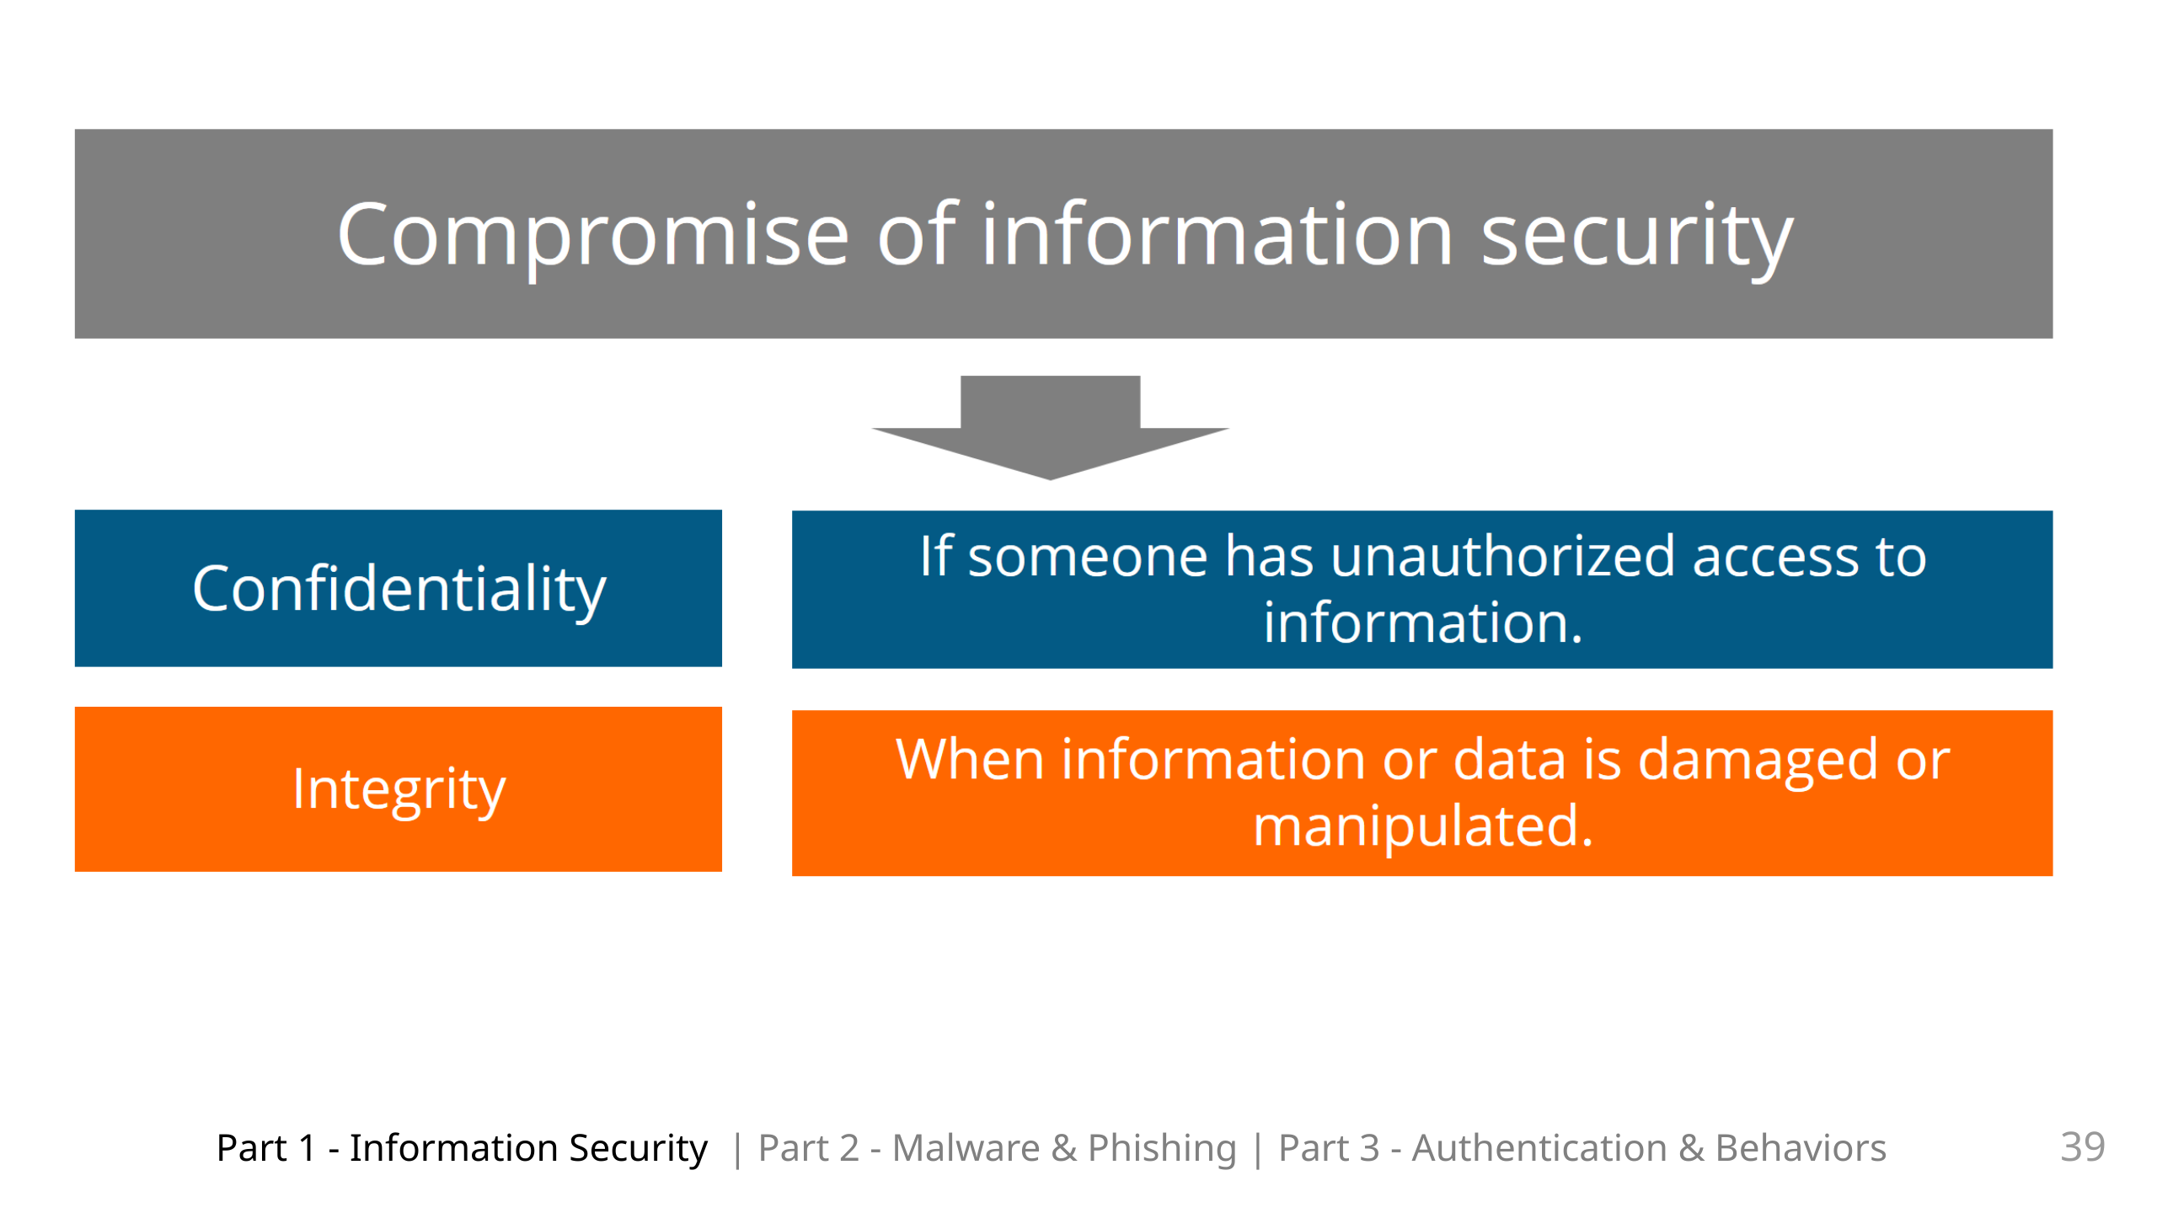

Slide 41
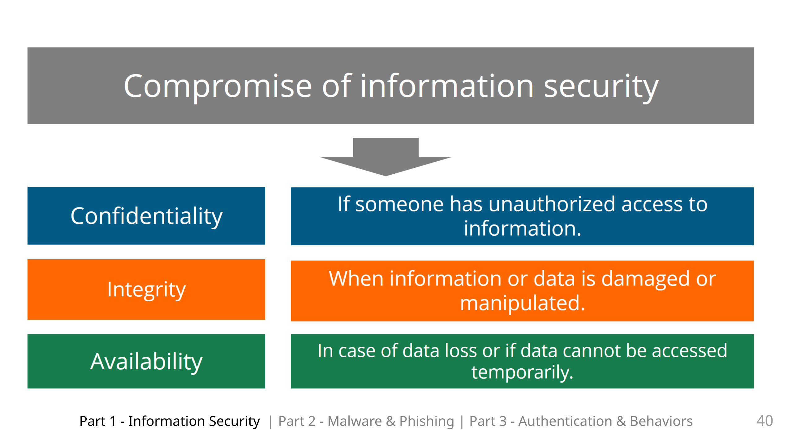

Slide 42
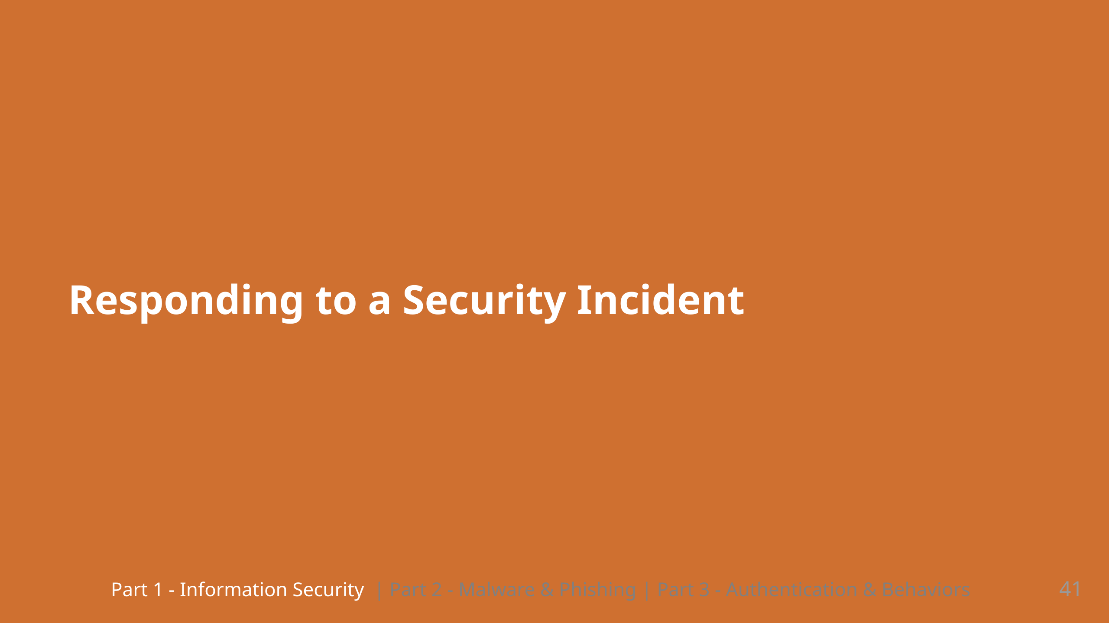
Notes:
And if we have a Security incident, how do we respond?

Slide 43
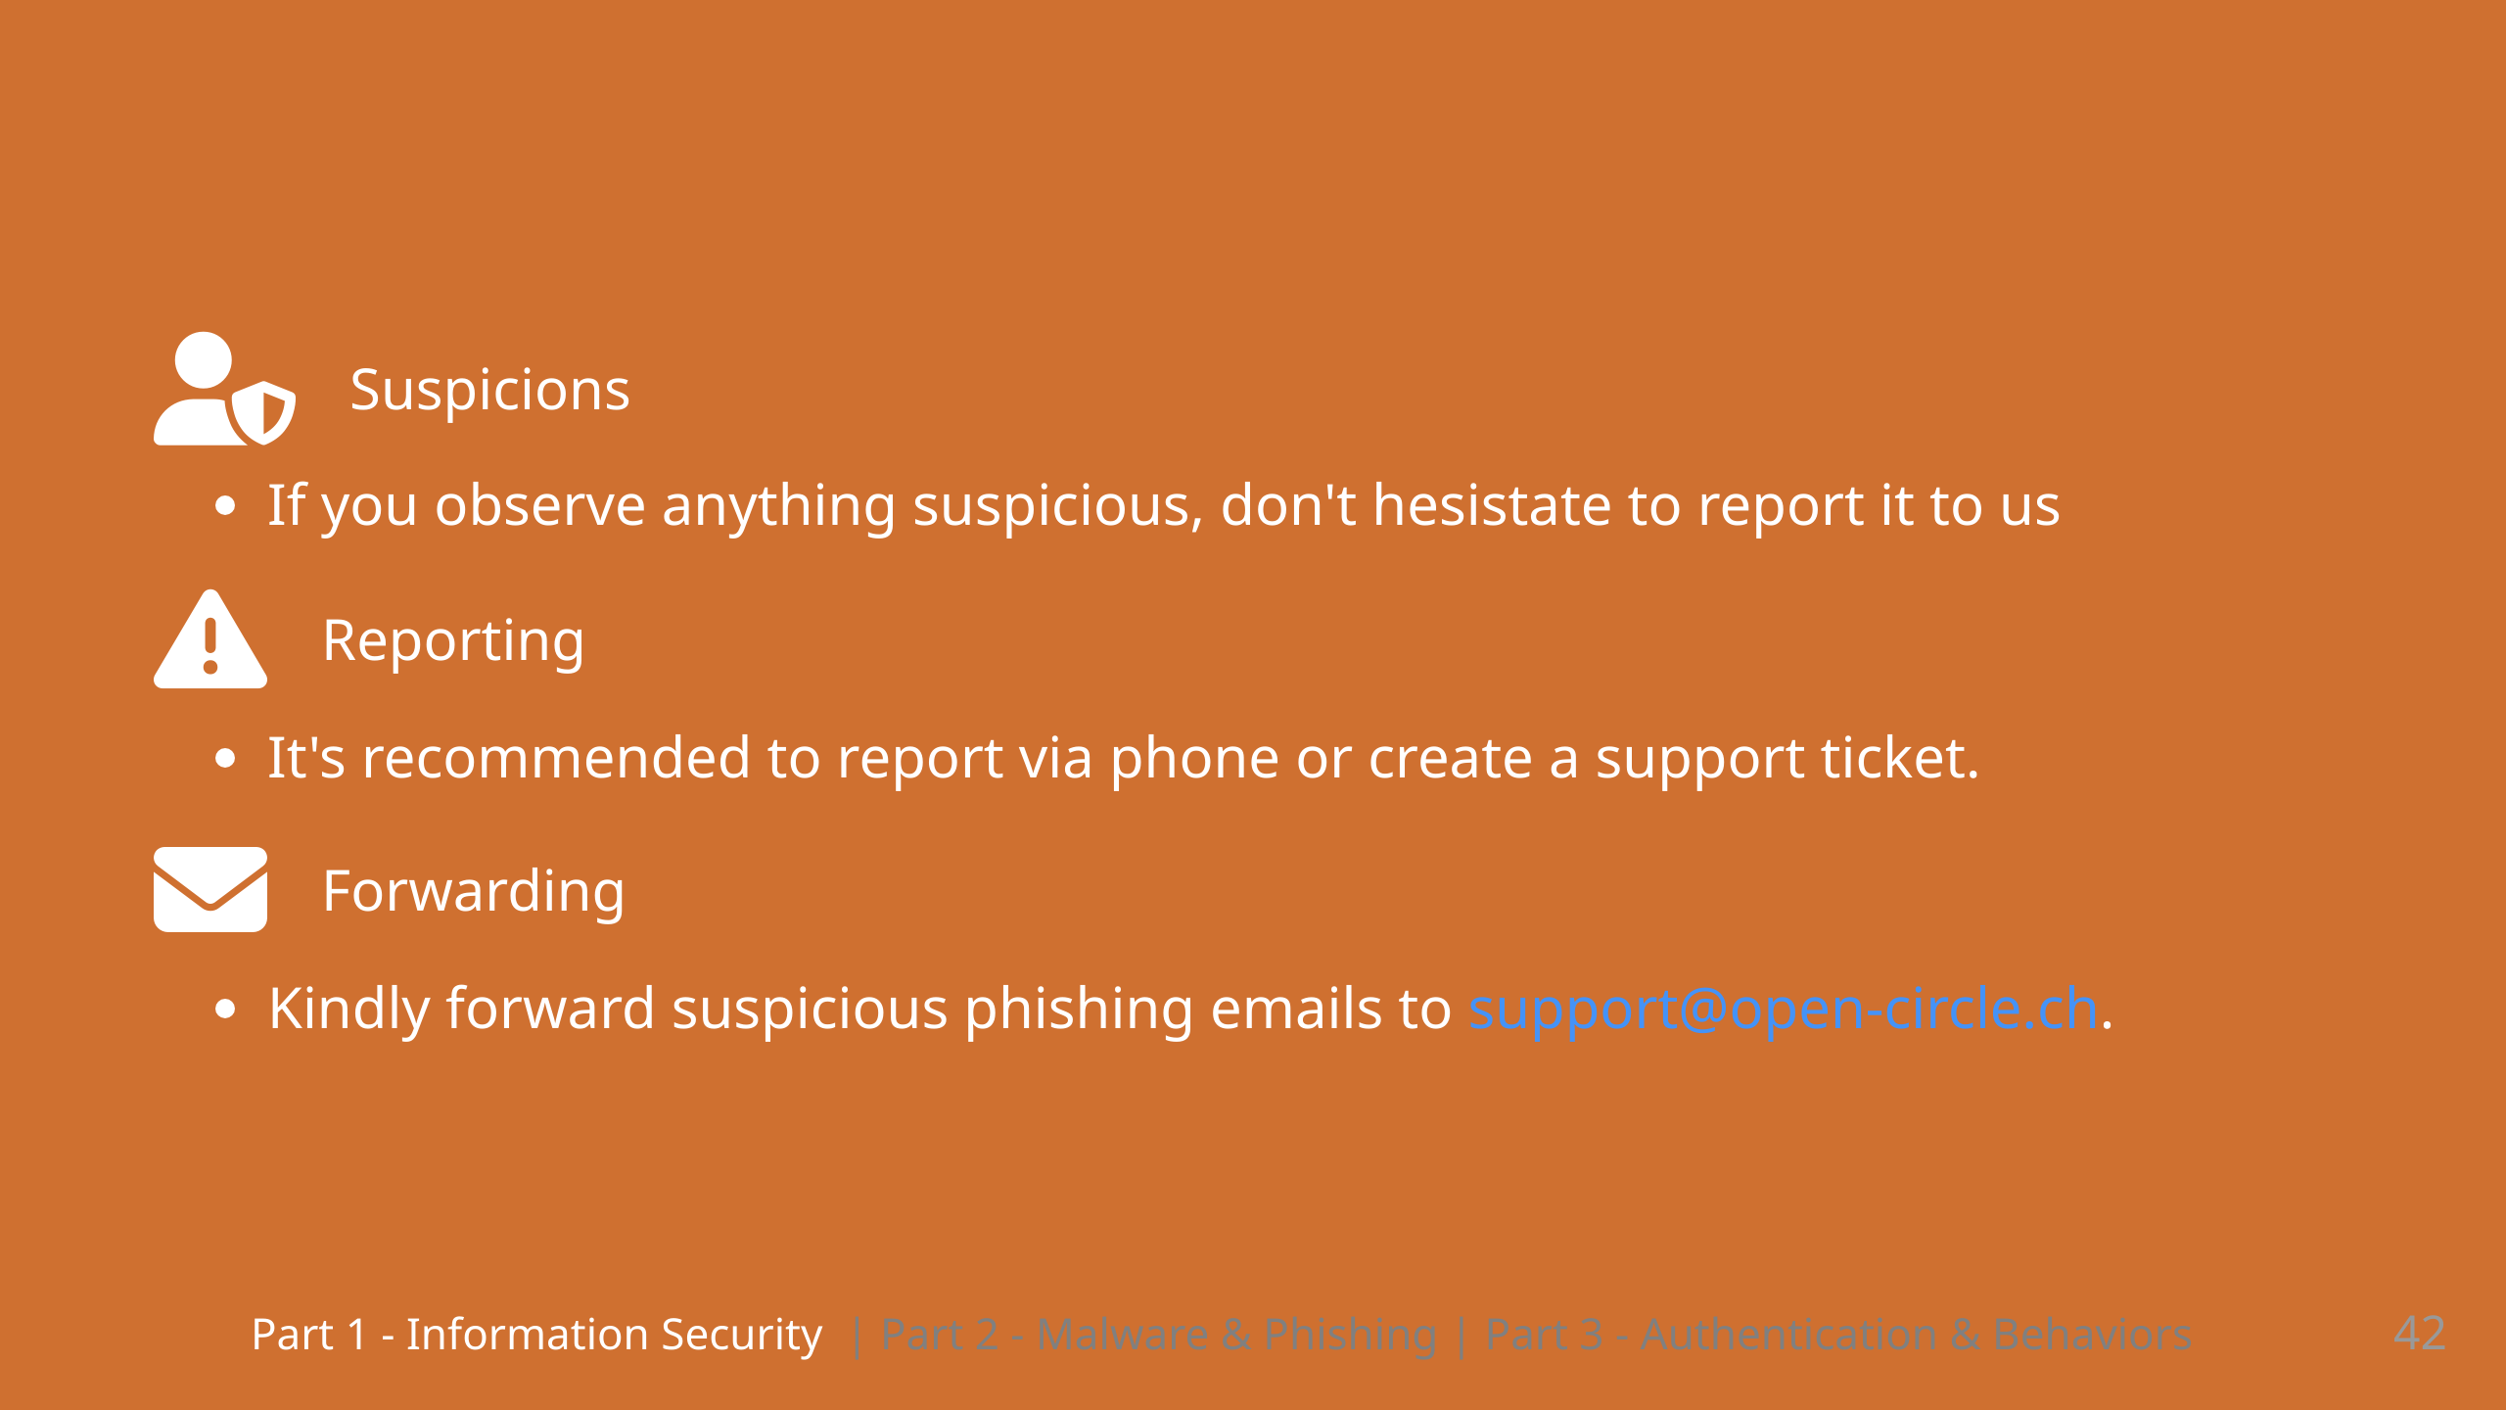
Notes:
We are here for you Our experts will take the necessary actions to deal with the incident You can also add screenshots to a ticket to provide us with more information

Slide 44
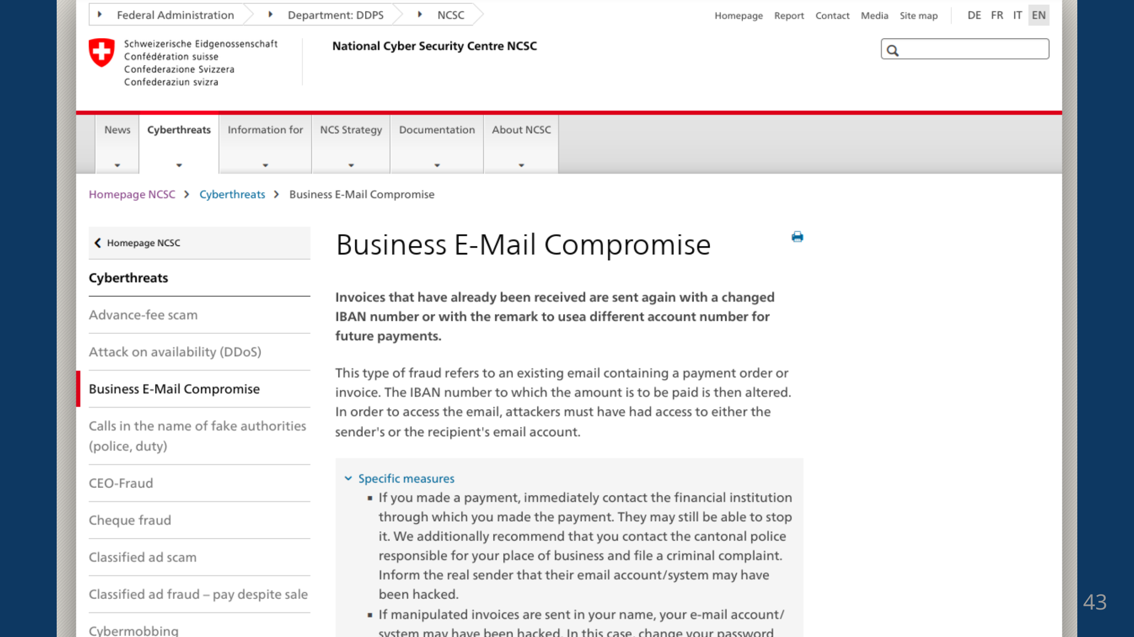

Slide 45
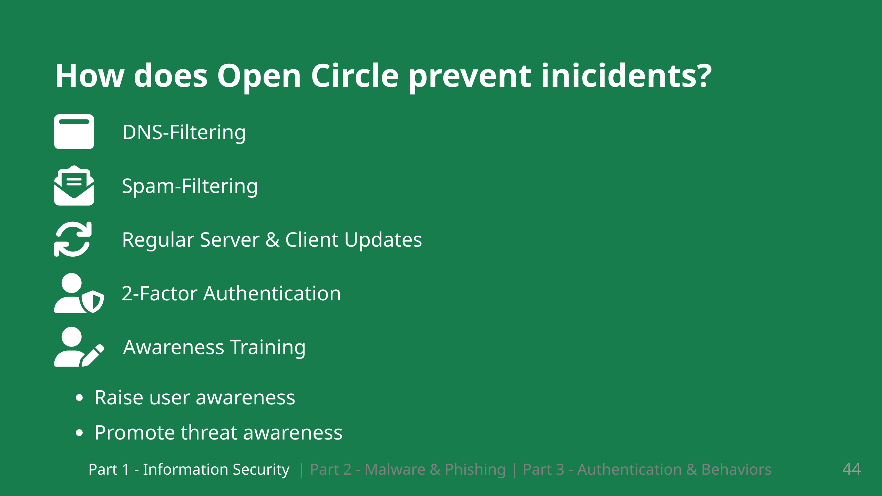
Notes:
There are a lot of technical tools. but in the end you as individuals have a big influence on information security. This is also the reason why we're having this training today: To raise your awareness as a user and to give an understanding of some of the threats that exist.

Slide 46
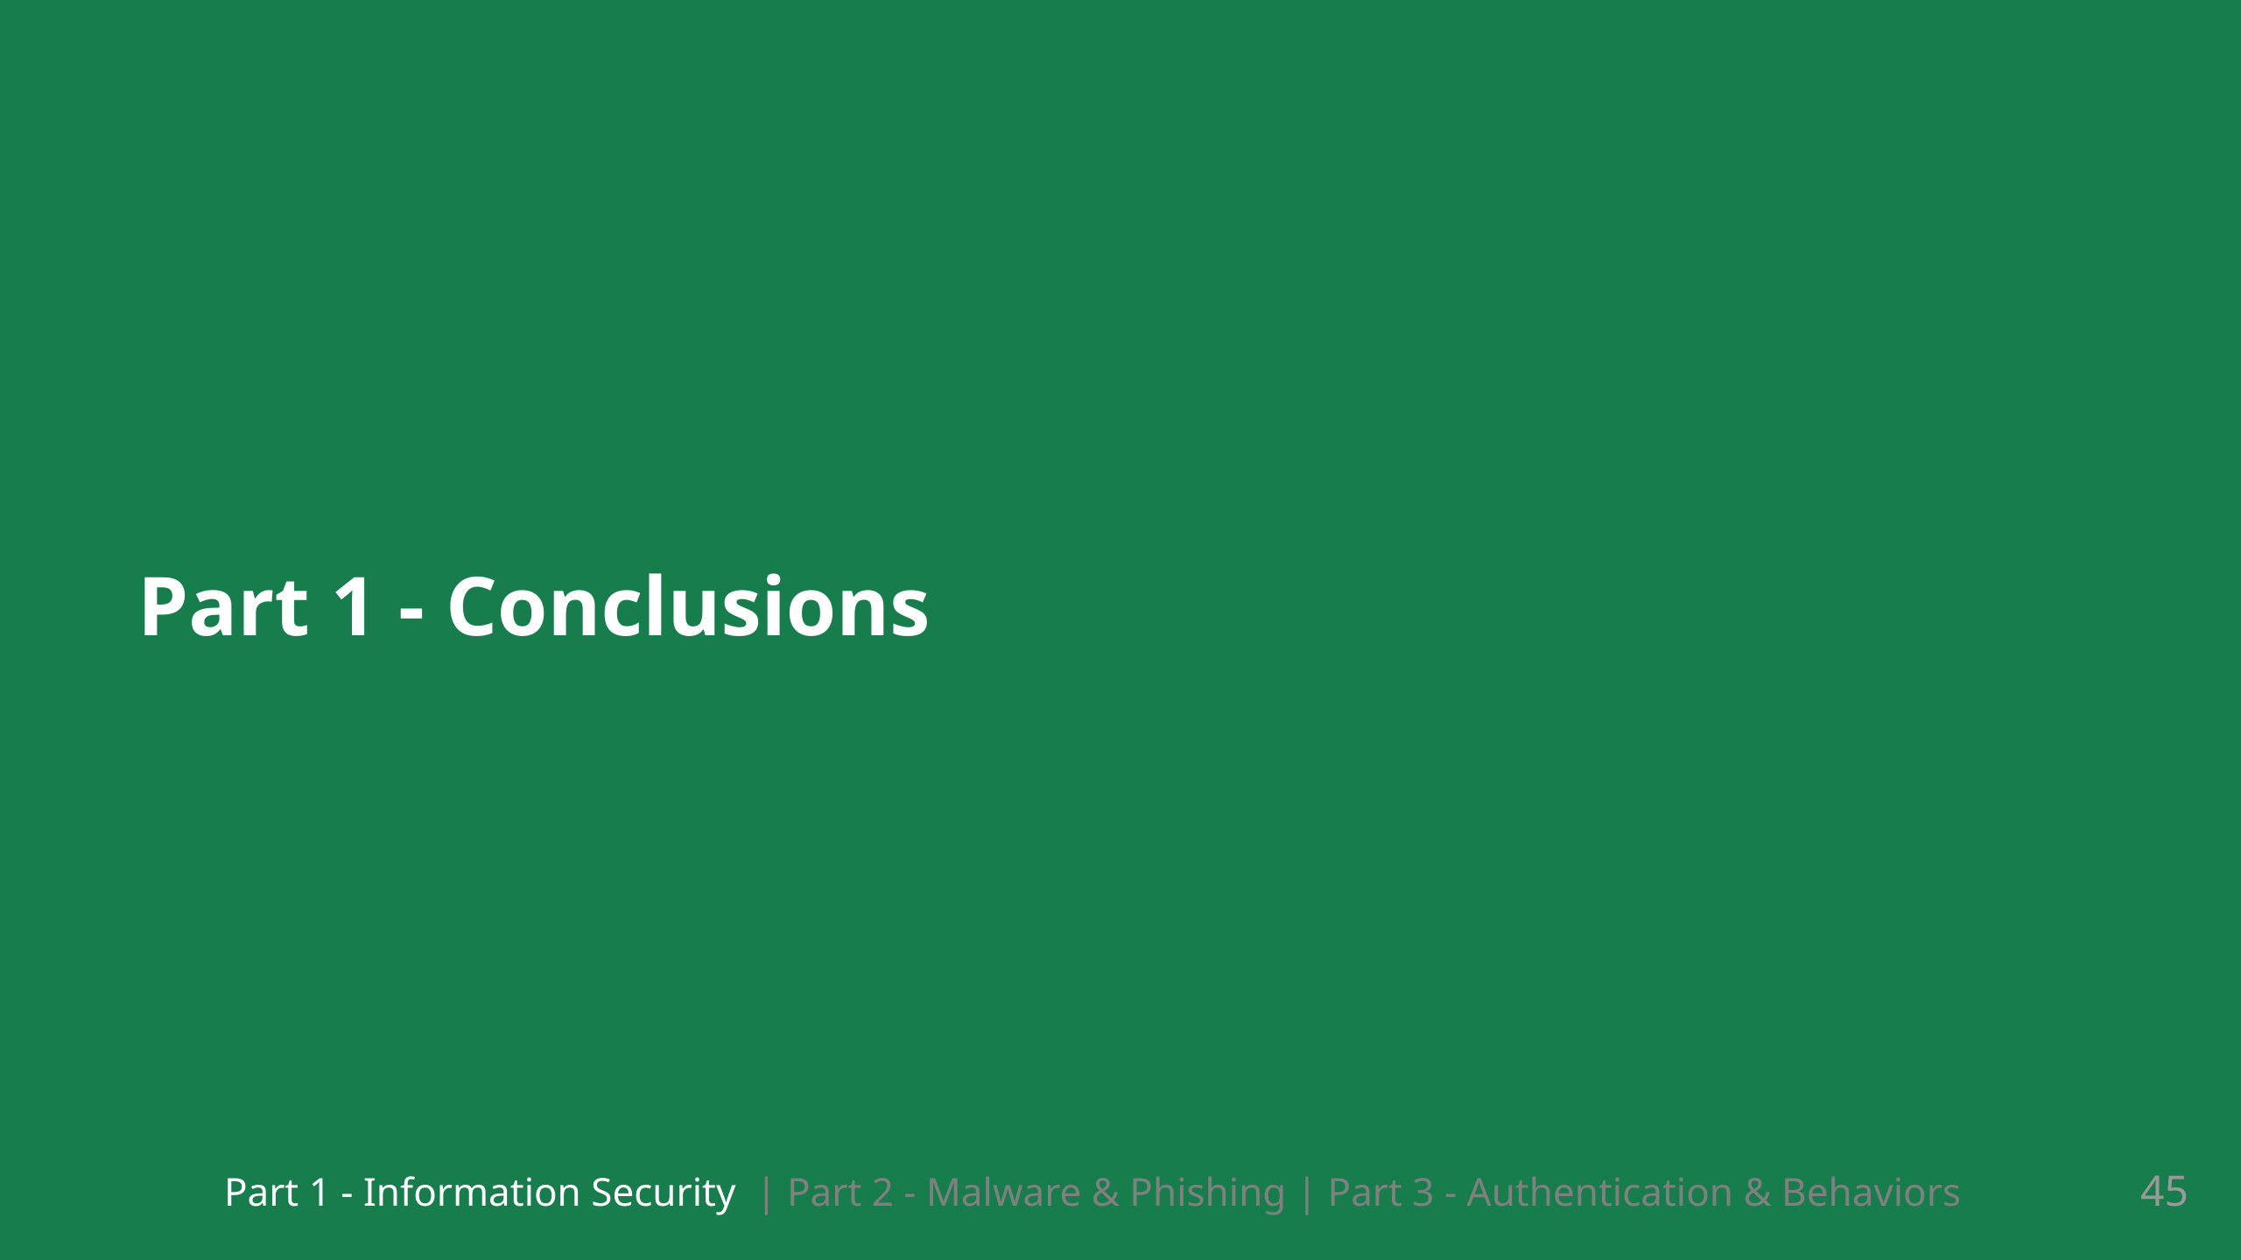
Notes:
So we are concluding the first part

Slide 47
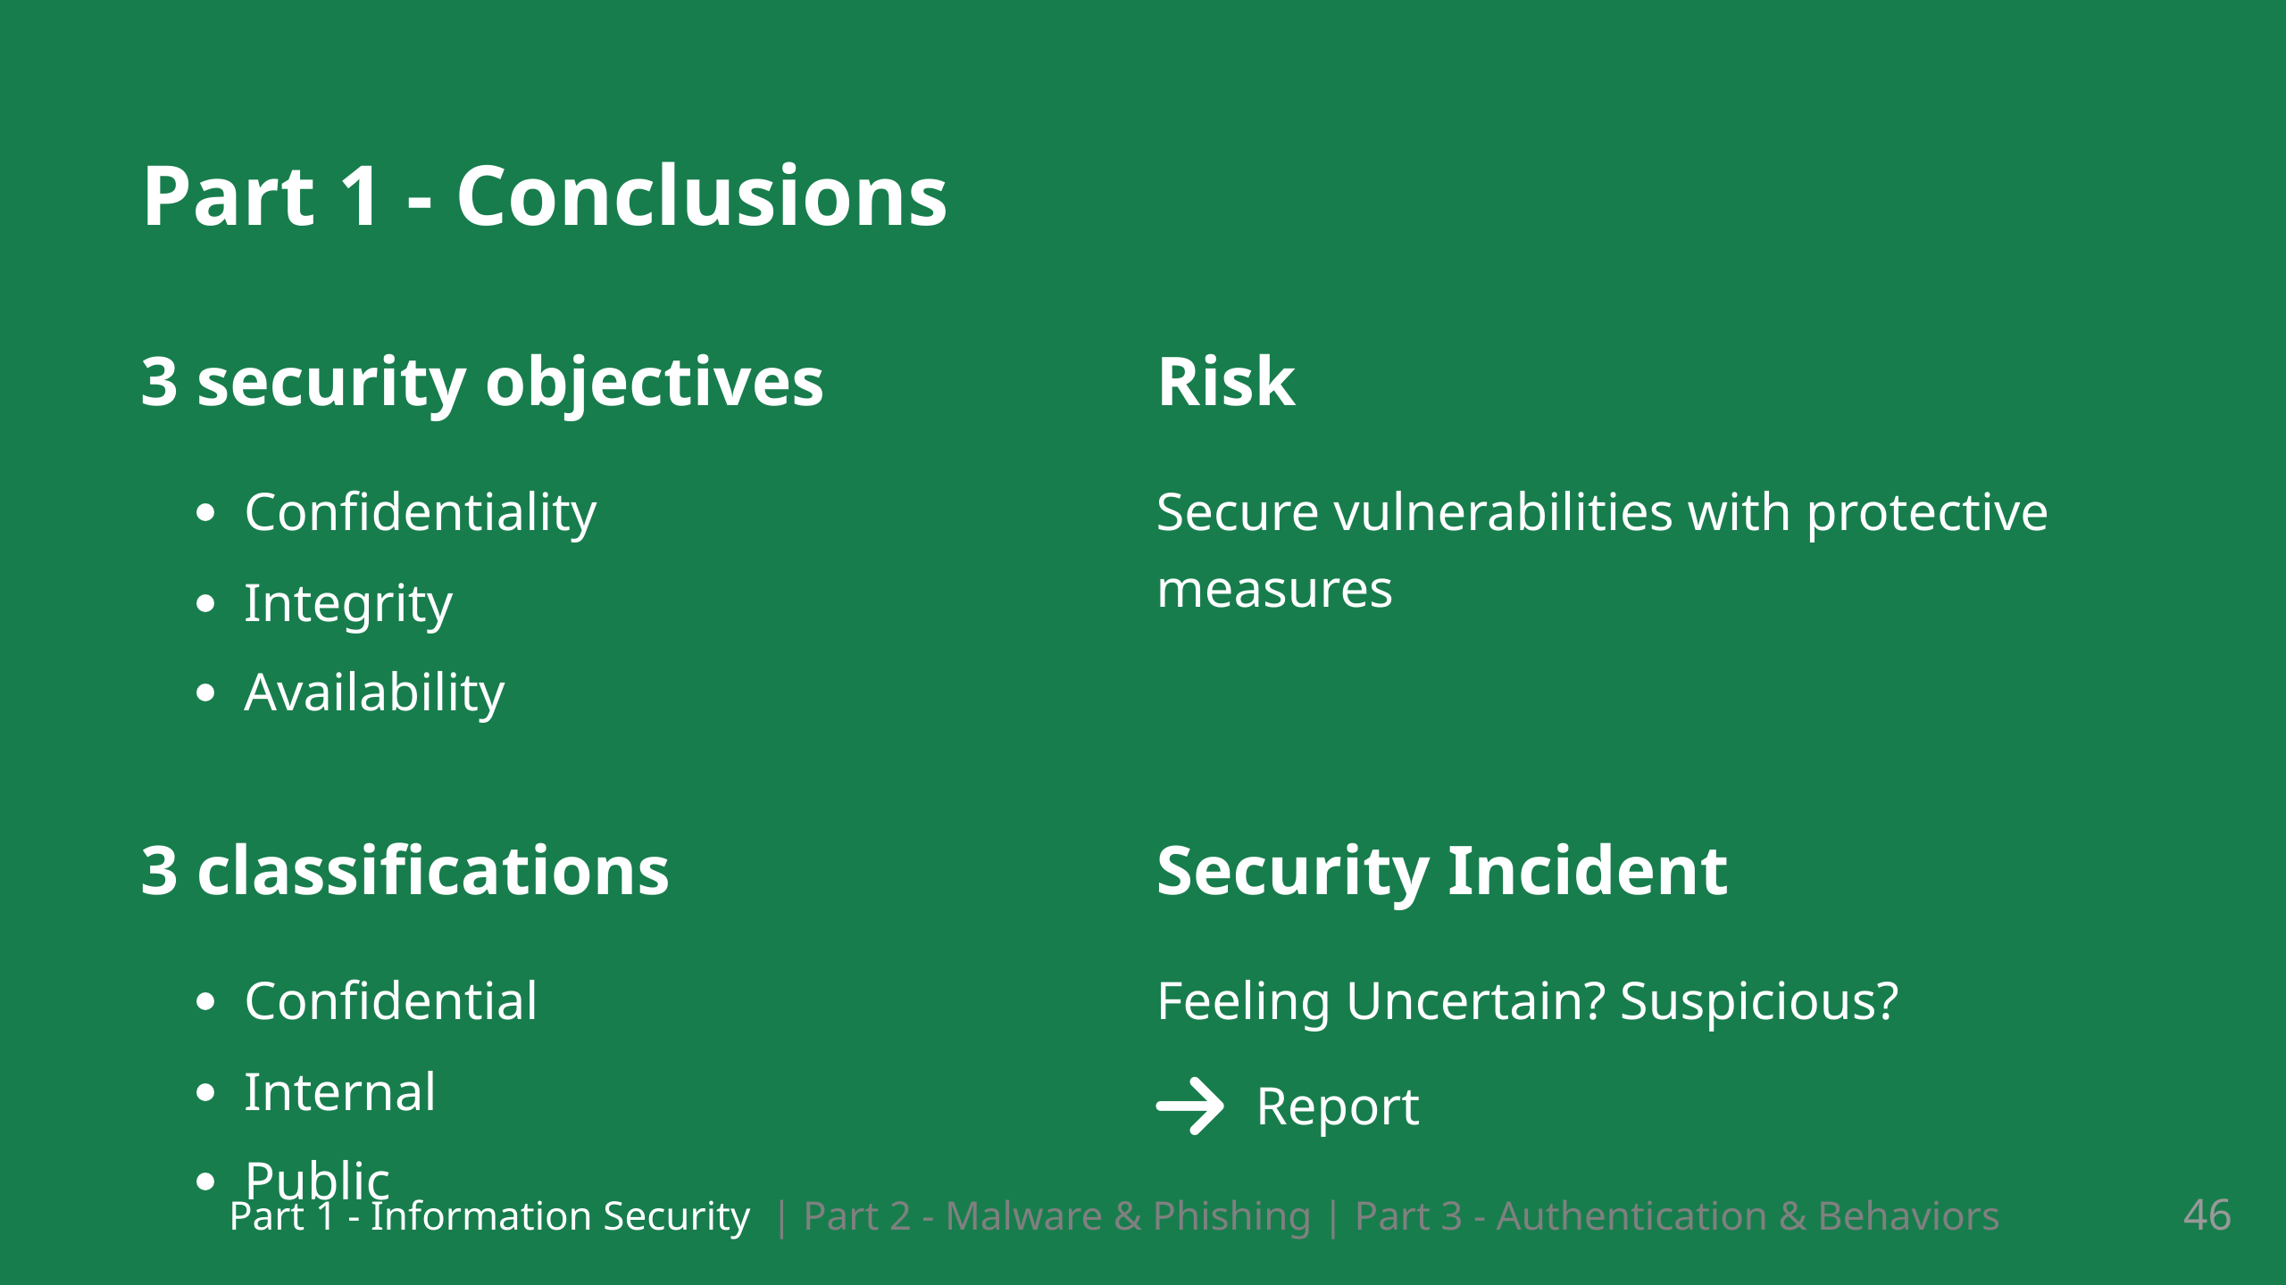
Notes:
5 Minuten Pause

Slide 48
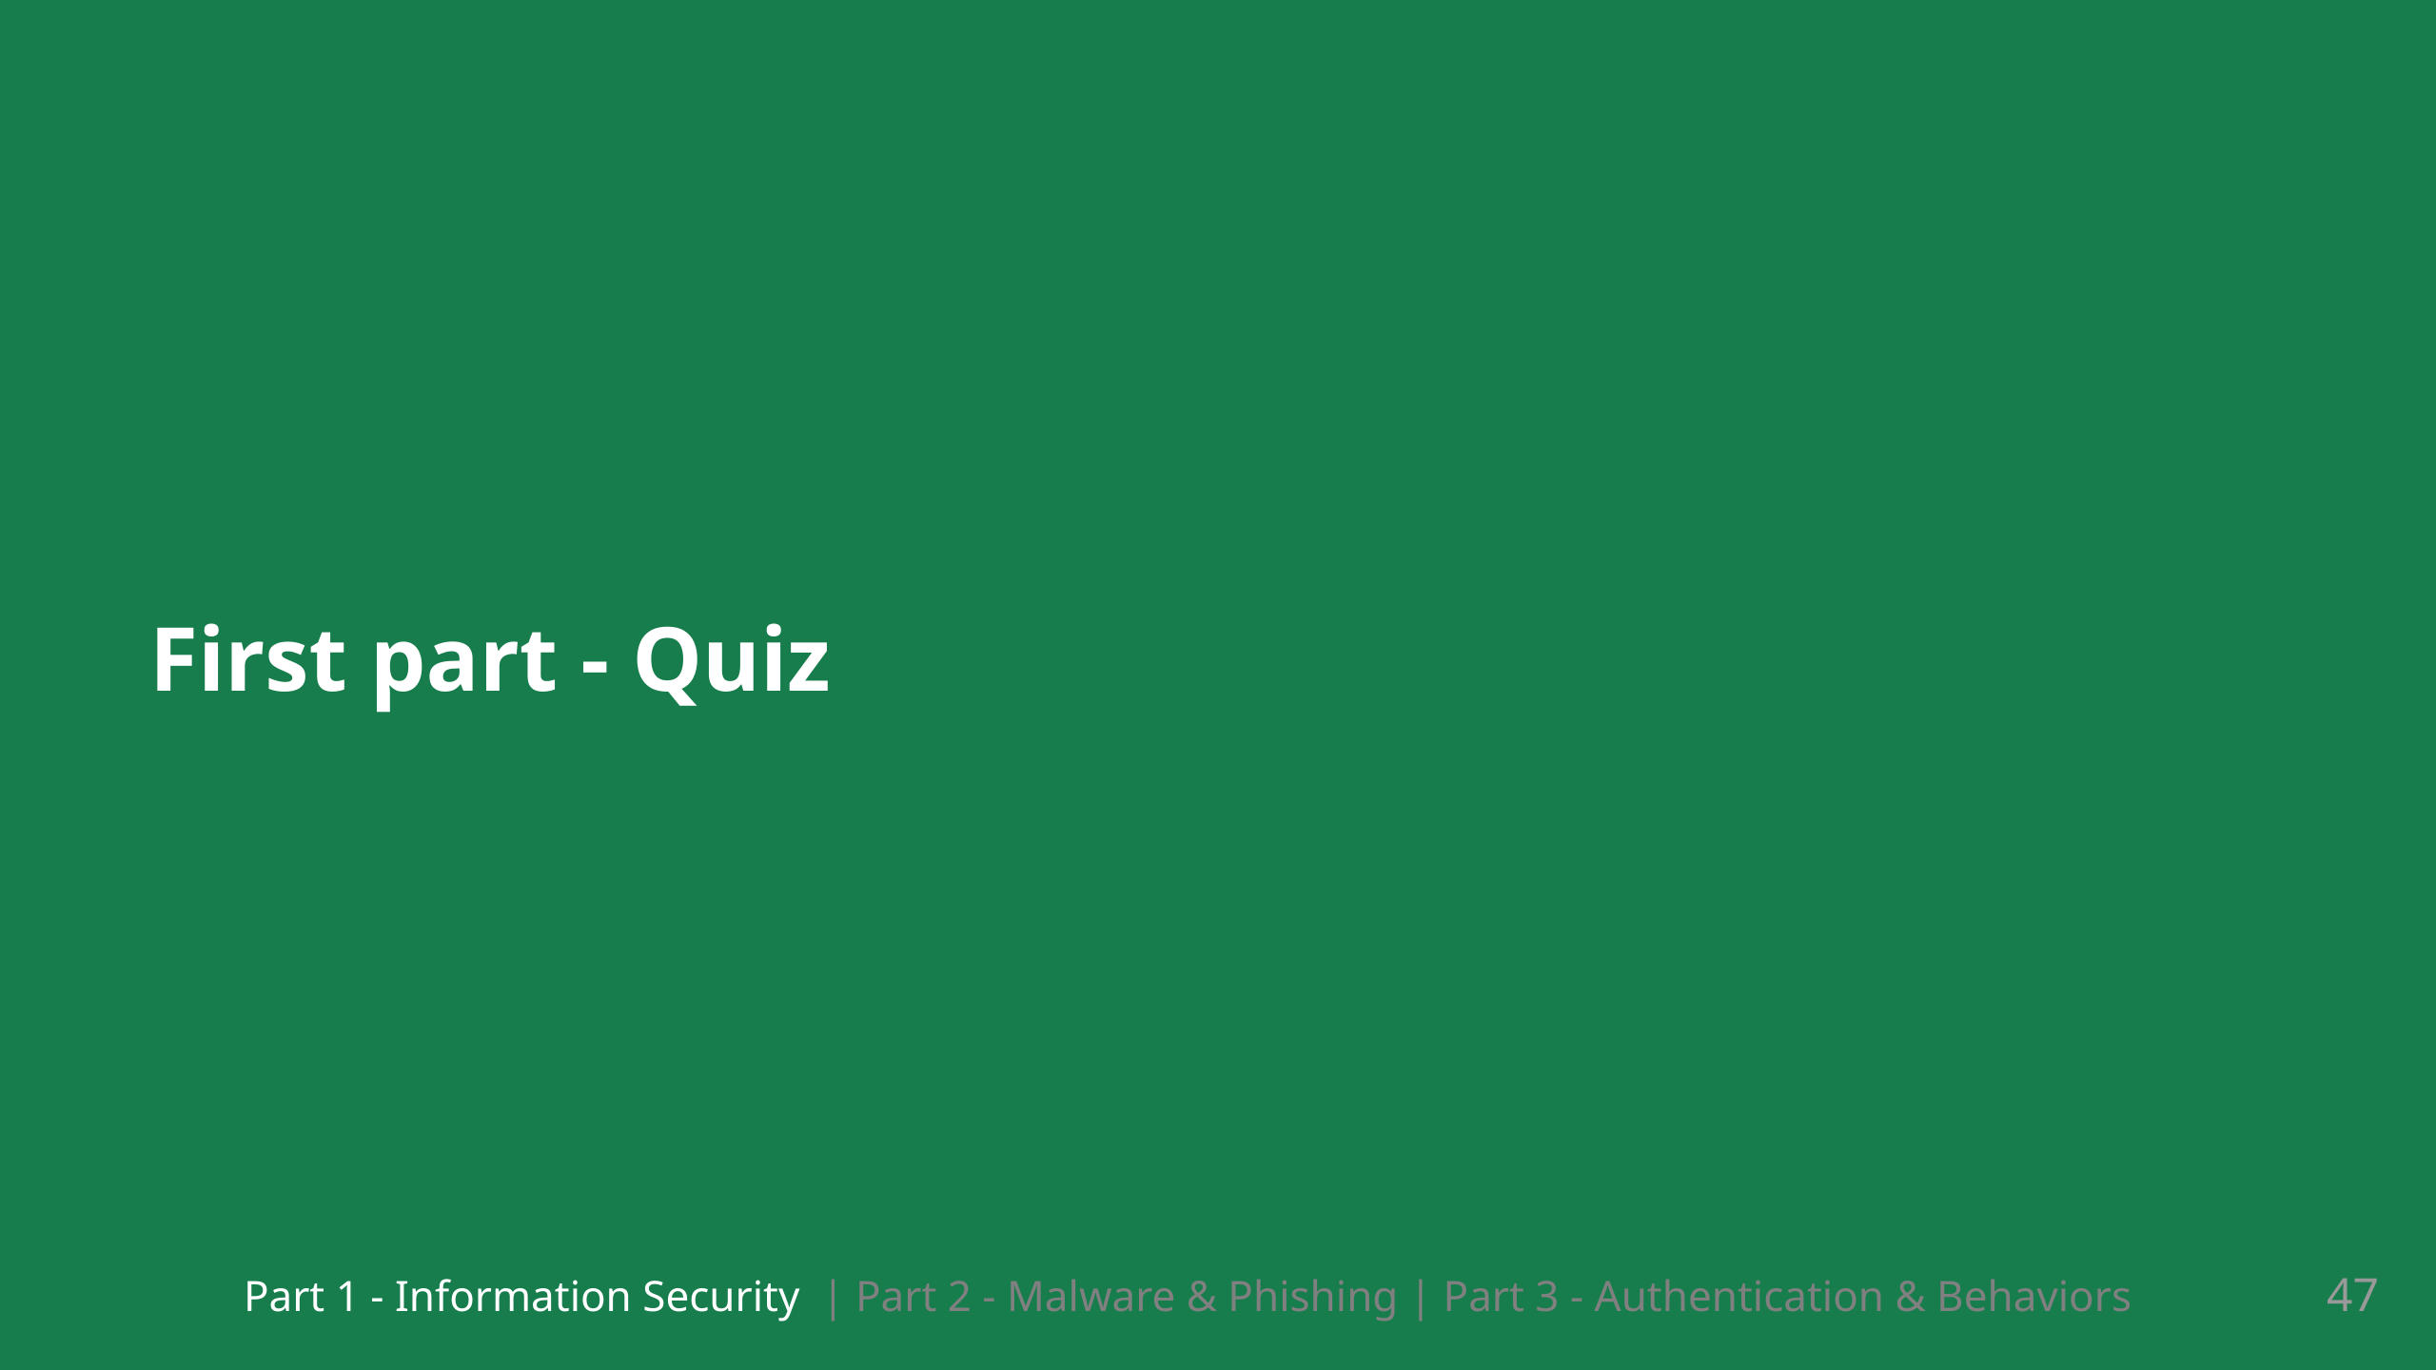
Notes:
Do you have any questions for this first part of our training?

Slide 49
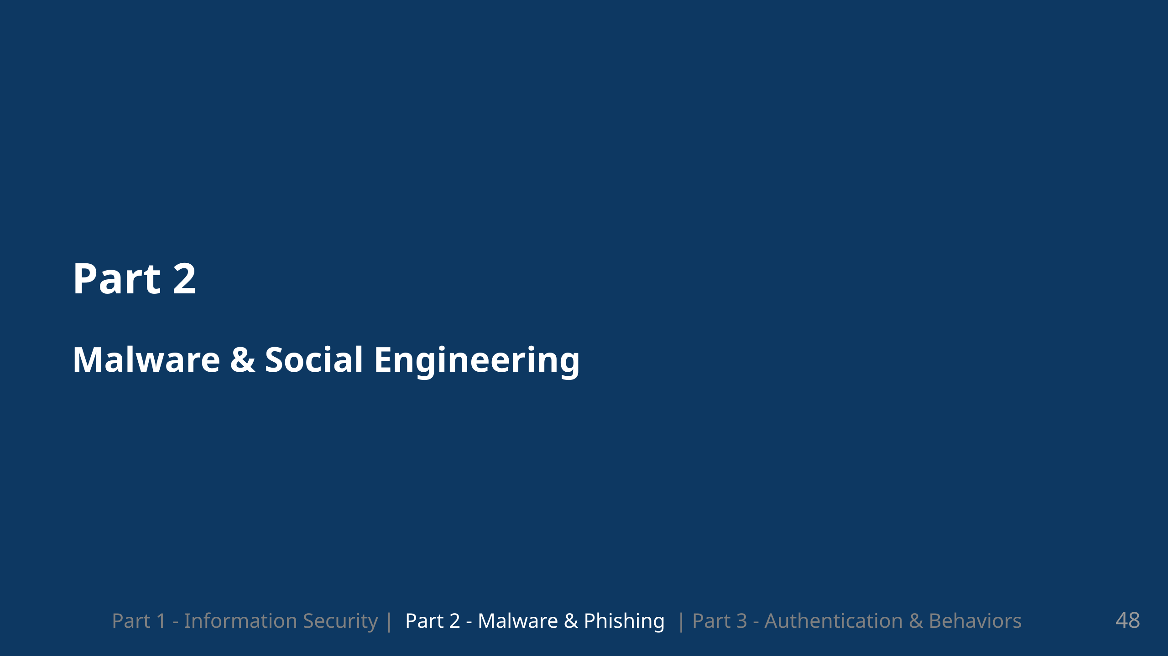
Notes:
In our second part of this training we will look at technologies leveraged by attackers What do they use? How does itwork and this also helps us to understand what we need to do to protect ourselves

Slide 50
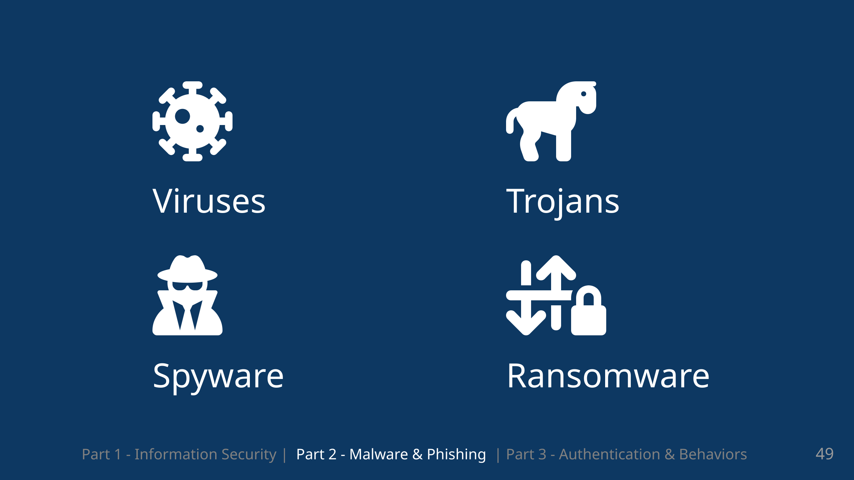
Notes:
So we will look at four groups of malware today. There are many subgroups and variants but we will focus on these as they are some of the most important ones to know

Slide 51

Notes:
The name virus itself indicates that there are similiarities to biological viruses, Viruses are software that focus on infiltrating files and systems and to replicate themselves. Damage: Data destruction, system crashes, network propagation.

Slide 52

Notes:
So most definitiely famous, at least when it comes to the namesake are trojans. And as the name indicates, its about disguising an attack. Data theft, identity theft, complete system takeovers

Slide 53

Notes:
Privacy breaches, identity theft, financial losses.

Slide 54

Notes:
Data loss, financial losses, business interruptions.

Slide 55

Notes:
Global Impact: WannaCry infected over 230,000 computers across 150 countries within days. It spread by exploiting a vulnerability in the Windows operating system called EternalBlue (a flaw that had already been patched by Microsoft but was unpatched in many systems). Behavior: The ransomware encrypted users' files, demanding a ransom in Bitcoin to restore access. If users failed to pay the ransom, their data remained inaccessible. Notable Targets: Several major institutions were severely impacted. For example: The UK’s National Health Service (NHS) had to cancel surgeries and medical appointments because WannaCry disabled their computer systems. Large corporations such as FedEx and Telefonica also faced major disruptions. Prevention & Aftermath: The attack highlighted the importance of keeping systems updated with security patches, as well as implementing backup and recovery plans. It also showcased the need for increased international cooperation to combat cybercrime.

Slide 56

Notes:
Global Impact: WannaCry infected over 230,000 computers across 150 countries within days. It spread by exploiting a vulnerability in the Windows operating system called EternalBlue (a flaw that had already been patched by Microsoft but was unpatched in many systems). Behavior: The ransomware encrypted users' files, demanding a ransom in Bitcoin to restore access. If users failed to pay the ransom, their data remained inaccessible. Notable Targets: Several major institutions were severely impacted. For example: The UK’s National Health Service (NHS) had to cancel surgeries and medical appointments because WannaCry disabled their computer systems. Large corporations such as FedEx and Telefonica also faced major disruptions. Prevention & Aftermath: The attack highlighted the importance of keeping systems updated with security patches, as well as implementing backup and recovery plans. It also showcased the need for increased international cooperation to combat cybercrime.

Slide 57

Notes:
link: https://www.microsoft.com/en-us/security/blog/2022/06/13/the-many-lives-of-blackcat-ransomware/ Die ist ein Beispiel einer Nachricht die von einer Ransomware gruppe eingebelendet wird wenn mit black cat, Ransomware, was eine variante von Ransomware ist

Slide 58

Notes:
So we talked about malware and i commented on the spread of it. So attackers use different attack components to get malware on systems

Slide 59


Slide 60


Slide 61

Notes:
So drive by downloads are downloads done in a drive by, well for browsing it would just be visiting a home page Leveraging javascript Unnoticed infection, propagation of viruses, trojans, or ransomware.

Slide 62

Notes:
link: https://us.norton.com/blog/malware/what-are-drive-by-downloads

Slide 63

Notes:
So the recommendation here for unauthorized drive by downloads, since they work without direct interactions, is to update and especially update the browser as often as possible or at least as often as it prompts you to

Slide 64


Slide 65


Slide 66

Notes:
A technical tool used often in combination with other tools are rootkits. They basically use the different levels of access which come with different users, such as the root user where the name comes from, to get authorization to execute certain commands. It is often used to disguised, to hide other malware and their action

Slide 67


Slide 68

Notes:
What can we do to protcet ourselves As i said before with the browsers, but also for other software and the os in general.

Slide 69

Notes:
Also used by attackers are social tactics which are pretty much equally as important and dangerous.

Slide 70

Notes:
We see this with phishing and with vishing which is phishing but with voice so by telephone

Slide 71

Notes:
Identity theft, financial losses, unauthorized access to personal accounts.

Slide 72

Notes:
We will look at some differnt types groupings of phishing just to see what forms of it exist. These are of course not all types of phishing but some of the more prevalent tactics Account information alerts: This is usually about missing information, could be payment data or other information Also popular with things like netflix, amazon etc is account suspension based on different reasons

Slide 73

Notes:
We have account verification phishing which is when the want you to verify your account. Often from well known companies which provide services that many users use. Gives them a big net

Slide 74


Slide 75


Slide 76


Slide 77


Slide 78


Slide 79


Slide 80


Slide 81


Slide 82


Slide 83


Slide 84


Slide 85

Notes:
Potential theft of confidential data, risk of identity theft.

Slide 86


Slide 87


Slide 88


Slide 89


Slide 90


Slide 91

Notes:
SSL (Secure Sockets Layer) encryption, and its more modern and secure replacement, TLS (Transport Layer Security) uses both asymmetric and symmetric encryption Asymmetric encryption is used to establish a secure session between a client and a server symmetric encryption is used to exchange data within the secured session. Differences tls ssl: Cipher suites SSL protocol offers support for Fortezza cipher suite. TLS does not offer support. TLS follows a better standardization process that makes defining of new cipher suites easier like RC4, Triple DES, AES, IDEA, etc. Alert messages SSL has the “No certificate” alert message. TLS protocol removes the alert message and replaces it with several other alert messages. Record Protocol SSL uses Message Authentication Code (MAC) after encrypting each message while TLS on the other hand uses HMAC — a hash-based message authentication code after each message encryption. Handshake process In SSL, the hash calculation also comprises the master secret and pad while in TLS, the hashes are calculated over handshake message.

Slide 92


Slide 93


Slide 94


Slide 95


Slide 96


Slide 97


Slide 98

Notes:
# Zoom Poll / Quiz 5 Minuten Pause

Slide 99


Slide 100

Notes:
If the verification is successful, the user or device is considered authentic and is granted access to the relevant resources or services. There is also authorization after they have been authenticated. It defines the permissions and privileges associated with a specific identity.

Slide 101


Slide 102

Notes:
Passwords we said are vulnerable to phishing and social engineering, but they can also be vulnerable to brute forcing I wont provide any concrete times on password brute forcing since it can change very quickly in either direction. What i will say, is that wordlists have a significant influence on the time it takes to brute force

Slide 103


Slide 104


Slide 105

Notes:
in January 2019, a large collection of credential stuffing lists (combinations of email addresses and passwords used to hijack accounts on other services) was discovered being distributed on a popular hacking forum. The data contained almost 2.7 billion records including 773 million unique email addresses alongside passwords Some Passwordmanagers have a function built in which lets you check if your password is in a leaked list.

Slide 106


Slide 107


Slide 108

Notes:
mnemonic So you could use: my favorite movie is top gun 2 from 2023 + Tom Cruise MYFMITG2F2023+tc a device such as a pattern of letters, ideas, or associations that assists in remembering something, for example Richard Of York Gave Battle In Vain for the colours of the spectrum (red, orange, yellow, green, blue, indigo, violet).

Slide 109


Slide 110


Slide 111


Slide 112


Slide 113


Slide 114


Slide 115


Slide 116

Notes:
5 Minuten Pause

Slide 117

Notes:
# Zoom Poll / Quiz

Slide 118


Slide 119


